Slide 1
FEDERAL ELECTION
October 19, 2015

Slide 2
Federal Election Overview
The federal election is on October 19, 2015
Elections Canada is a non-partisan agency responsible for running the election and ensuring that Canadians are able to vote and be a candidate.
There are 338 ridings in Canada – you vote for a candidate running in your riding.
Elections Canada informs voters on when, where and the ways to register and vote. Go to elections.ca for all the information you need to be ready to vote.

Slide 3
Eligibility
Can I vote?
You can vote if you:
are a Canadian citizen
are at least 18 years old on election day
can prove your identity and address
For students under 18, your school can participate in Student Vote – a hands-on parallel election program: studentvote.ca

Slide 4
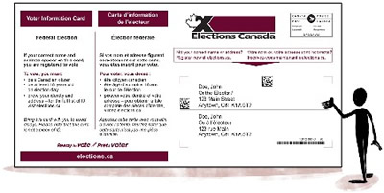
Registration
Am I registered to vote?
Make sure you’re registered
You can check, update or complete your registration at elections.ca.
Registering in advance is easy and will save you time when you go to vote.
Watch for your voter information card
Once you’re registered, you’ll get a card in the mail soon after the election is called.
It tells you when, where and ways to vote and the accessibility of your polling places.
Check your name and address on the card and contact Elections Canada if there are errors.

Slide 5
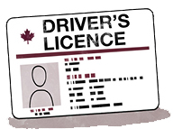
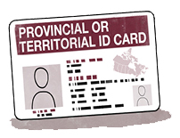
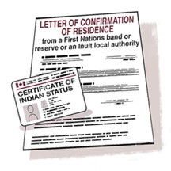
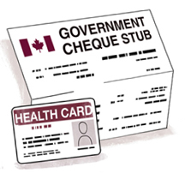
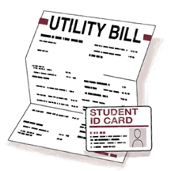
Voter Identification
What ID should I take with me?
To prove your identity and address:
Show 1 piece of government-issued ID with your photo, name and current address (e.g. driver’s licence or a provincial or territorial ID card).
OR
Show 2 pieces of ID. Both must have your name and 1 must have your current address (e.g. health card and a utility bill).
OR
Take an oath. Show two pieces of ID with your name and have someone who knows you attest to your address. They must show proof of identity and address, and be registered in the same polling division. They can attest for only one person.

Slide 6
Voter Identification – Helpful Tips
What else should I know?
Elections Canada accepts original ID cards and documents.
For documents issued electronically (such as e-statements or e-invoices), you can bring printouts or show them on a mobile device.
Take your voter information card with you when you go to vote. It cannot be used as proof of identity or address, but it will make the voting process faster.

Slide 7
Ways to Vote
What are the 4 ways to vote?
On election day, October 19, at your polling place
It will be open for 12 hours.
On one of four advance voting days, at your polling place
It will be open Friday, October 9 to Monday, October 12 from noon to 8:00 p.m.

Slide 8
Ways to Vote
What are the 4 ways to vote?
3. In person at any Elections Canada office
After the election is called, you can vote at any Elections Canada office across the country.
Offices are open 7 days a week (go before the deadline – 6:00 p.m. on Tuesday, October 13).
4. By mail
Apply online at elections.ca before 6:00 p.m. on Tuesday, October 13 to receive a voting kit.
Don’t wait! You need to allow enough time for your voting kit to reach you and for your marked ballot to reach Elections Canada by election day.
Can’t apply online? Call Elections Canada at 1-800-463-6868.

Slide 9
Where to Vote
How can I find my polling place?
Check your voter information card. It tells you where to vote.
Go to elections.ca and type your postal code into our Voter Information Service once the election is called.
Call 1-800-463-6868 or TTY 1-800-361-8935.
It’s always good to check – your polling place may have changed since the last time you voted.

Slide 10
Accessibility
What is available to make voting more accessible?
Polling place accessibility
Information on the accessibility of your polling places can be found on your voter information card or at elections.ca.
Either your polling place will have an automatic door opener, or an election worker will be at the door to provide assistance.
If you need assistance at any time in the voting process, please ask an election worker and tell them how they can help.
You can also bring a support person, friend or family member to assist you.

Slide 11
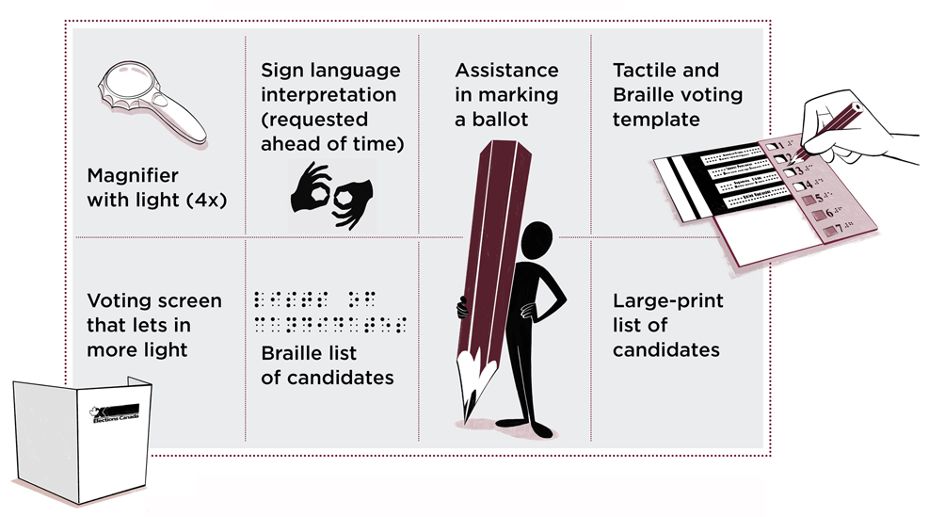
Accessibility
What is available to make voting more accessible?
Tools and services at your polling place:

Slide 12
Employment
How can I apply to work during the election?
Over 200,000 Canadians across the country are hired during an election. Learn more and apply online at elections.ca.
To work in an election, you need to:
be a Canadian citizen
be at least 16 years old (priority given to 18 or older)
live in the riding where you will be working (for most jobs)
remain non-partisan

Slide 13
Providing Feedback
How can I provide feedback to Elections Canada?
You can give feedback on your voting experience in several ways.
General feedback or complaints
Fill out a form at elections.ca.
Call Elections Canada at 1-800-463-6868 or TTY 1-800-361-8935.
Accessibility feedback
Fill out an accessibility feedback form at elections.ca or at your polling place.
Speak to an election worker at your polling place.

Slide 14
Spread the Word
How can I help spread the word about the election?
Digital shareable tools at elections.ca
Audio files, infographics, videos, e-bulletins and e-versions of print products.
A voter’s guide and the list of ID in 31 heritage and 12 Aboriginal languages.
Print products and other formats (Call 1-800-463-6868 to order them)
My Voter’s Guide, registration and ID flyer, list of ID and student flyer.
Audio, video, large print, DAISY, Braille, and sign language video (American Sign Language and Langue des signes québécoise).
Social media
Follow Elections Canada on social media and share election information.

Slide 15
Contact Elections Canada
How can I get more information?
Website: elections.ca
Telephone: 1-800-463-6868
During the election, telephone services are available in over 110 languages.
TTY: 1-800-361-8935
Social media
Elections Canada
@ElectionsCan_E
Elections Canada
ElectionsCanE

