Slide 1

World Issues

Slide 2
Unit 1 Lesson 2

Slide 3
Perspective & Bias
Sources
Cultural & Religious traditions
Opinion / Fact / Arguement

Slide 4

SPEEC Lenses
Social
Political
Economic
Environmental
Cultural

Slide 5
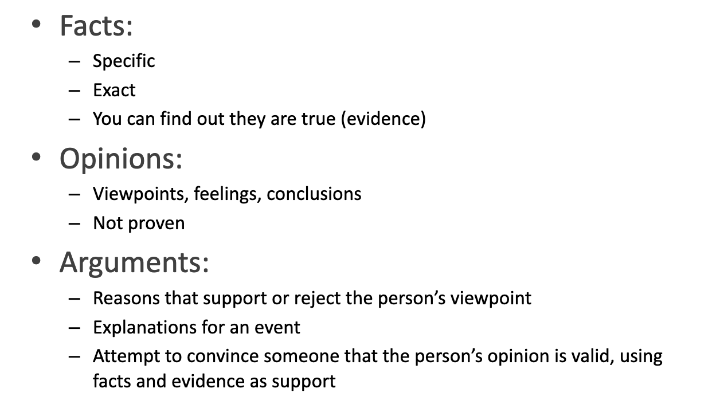

Slide 6

Thesis Statements
Your opinion + facts
What you believe about a topic and why.
A topic, a claim, and the supports (ideas or sources) you be using.

Slide 7
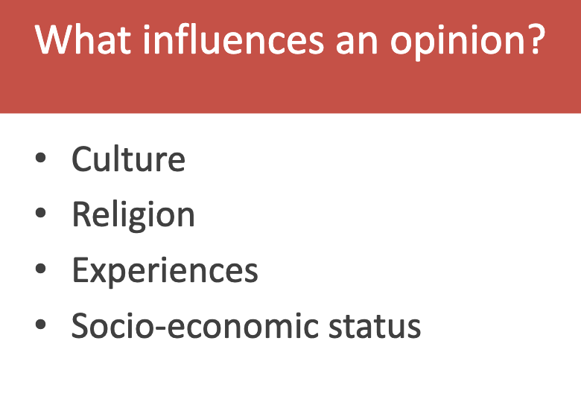

Slide 8
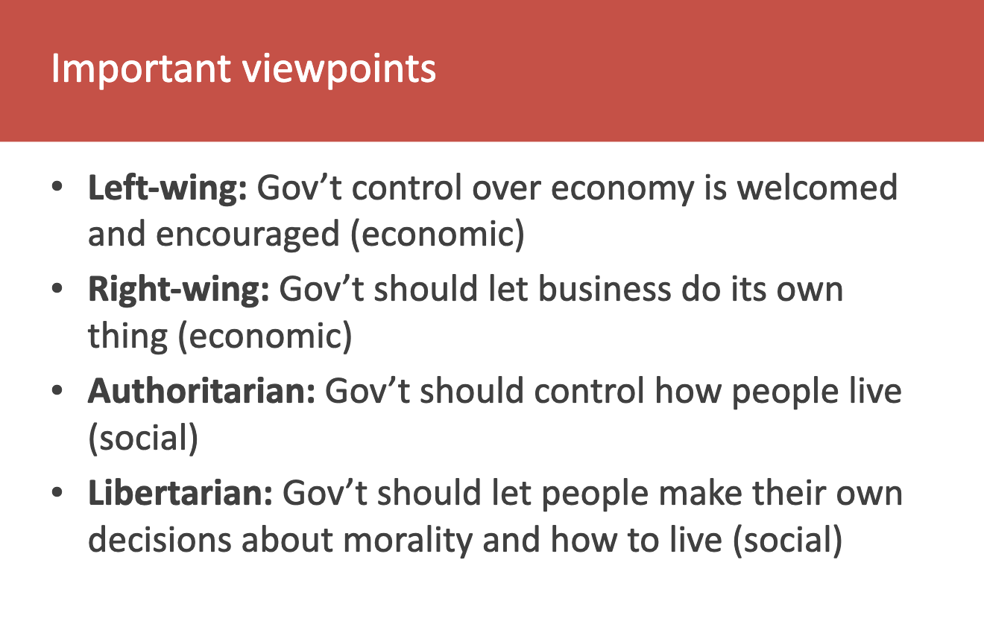

Slide 9
Unit 1 Lesson 3

Slide 10
The Media
What is the media?
Do you trust the media?
What do you think about Donald Trump expelling some media outlets?

Slide 11
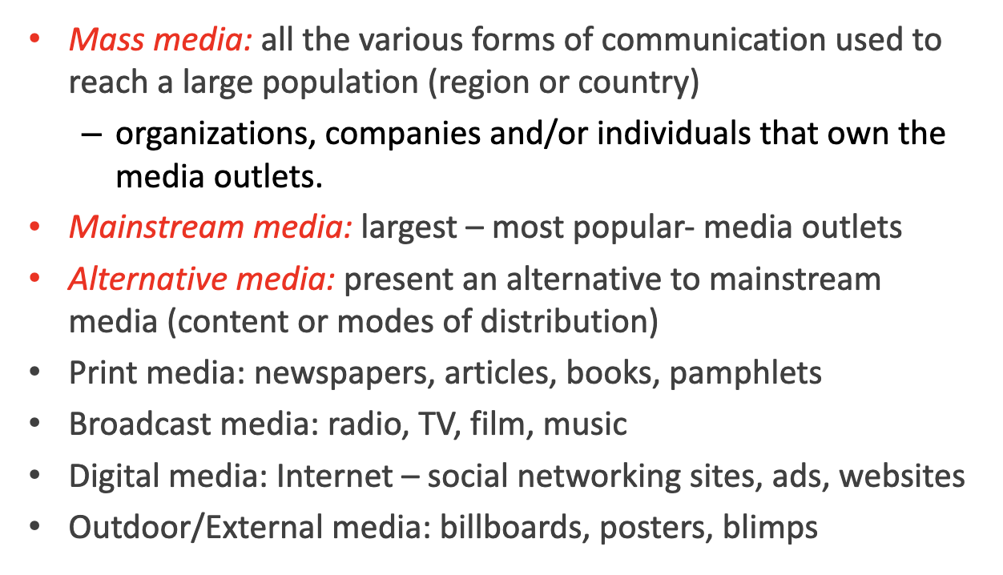

Slide 12


Slide 13
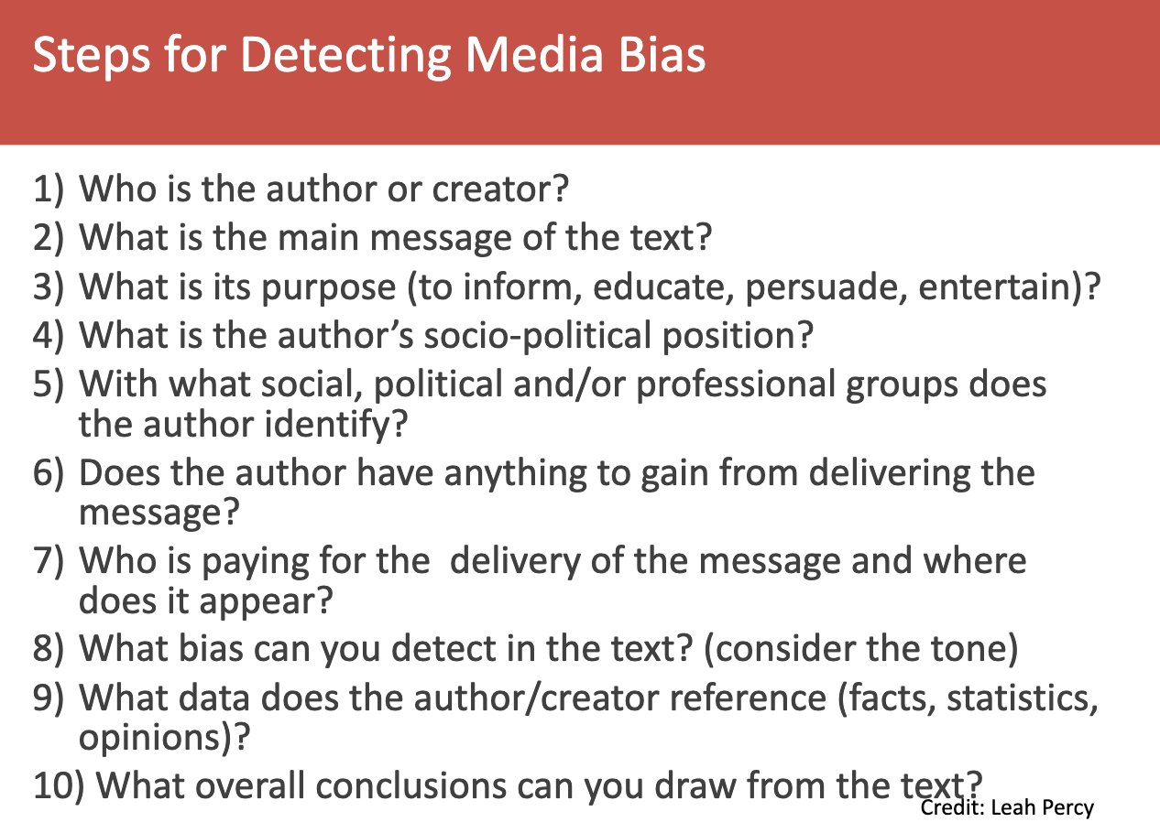

Slide 14
Lesson #4

Slide 15
This chapter is an example of the perspectives required in this course

Slide 16
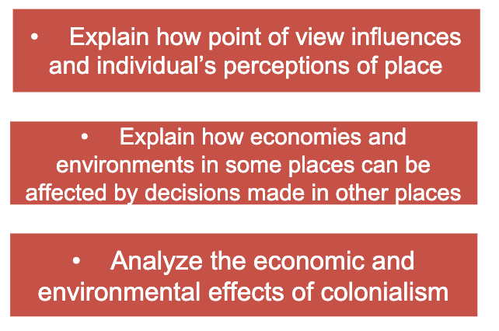

Slide 17

Colonialism
Settler Colonialism: Settlers move permanently to a new region, displacing or destroying the Indigenous population to build a new society.
Exploitation Colonialism: A smaller number of people oversee the extraction of local resources and use the native population for forced labor or low-cost work
the policy or practice of a powerful nation extending and maintaining its political, economic, and cultural control over another weaker territory or people.

Slide 18
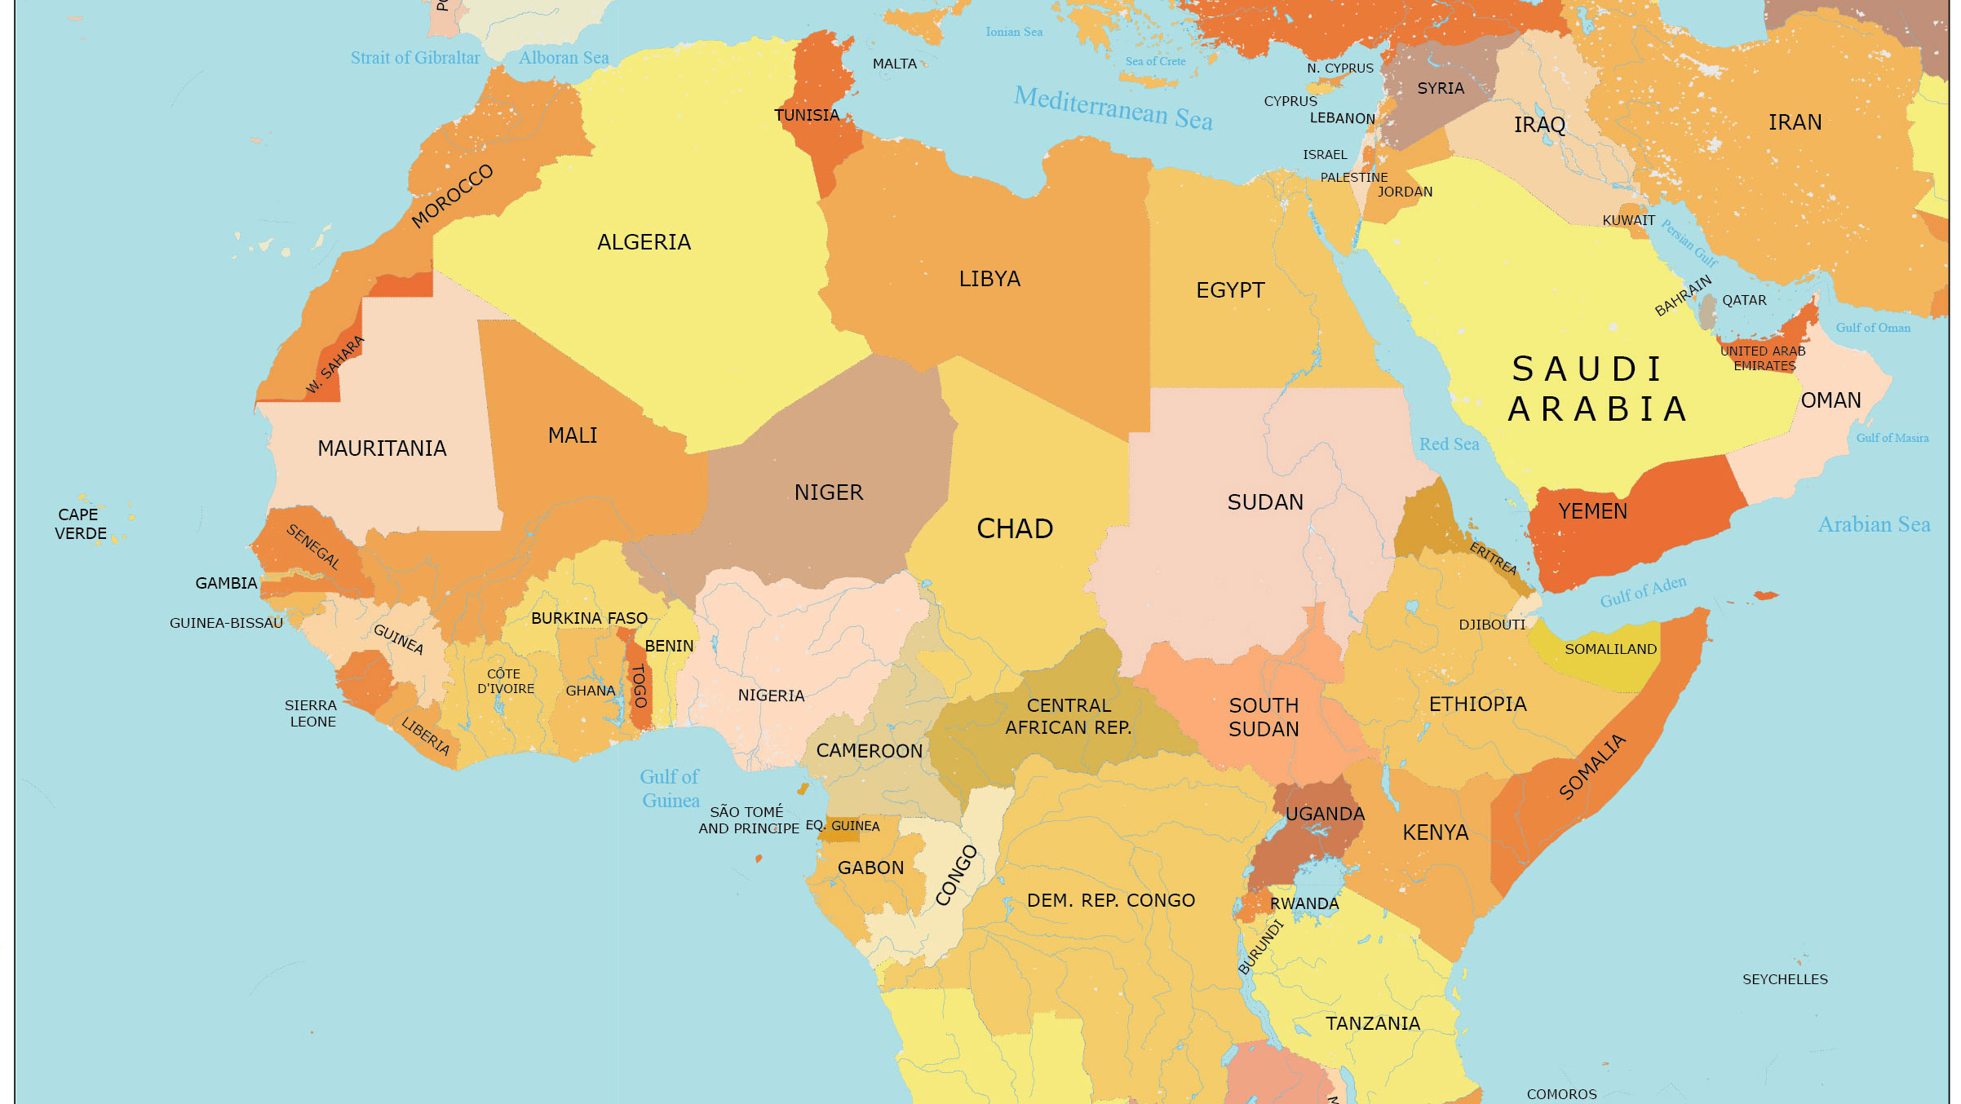

Slide 19
Lesson 5 - Neocolonialism

Slide 20
Review Chapter 4 for Colonialism also point out APA link on EdPlus website

Slide 21
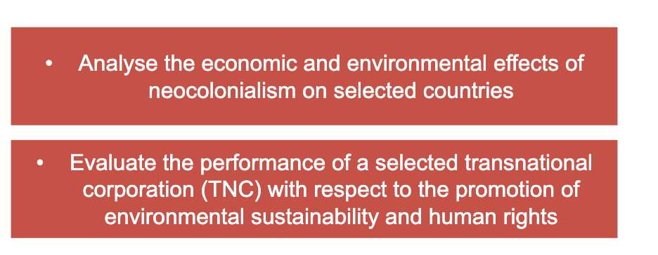

Slide 23
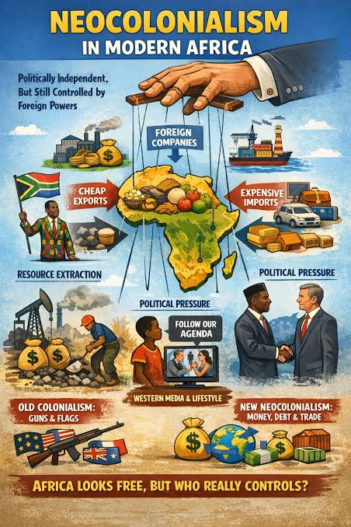
Exploitation
By companies instead of countries

Slide 24
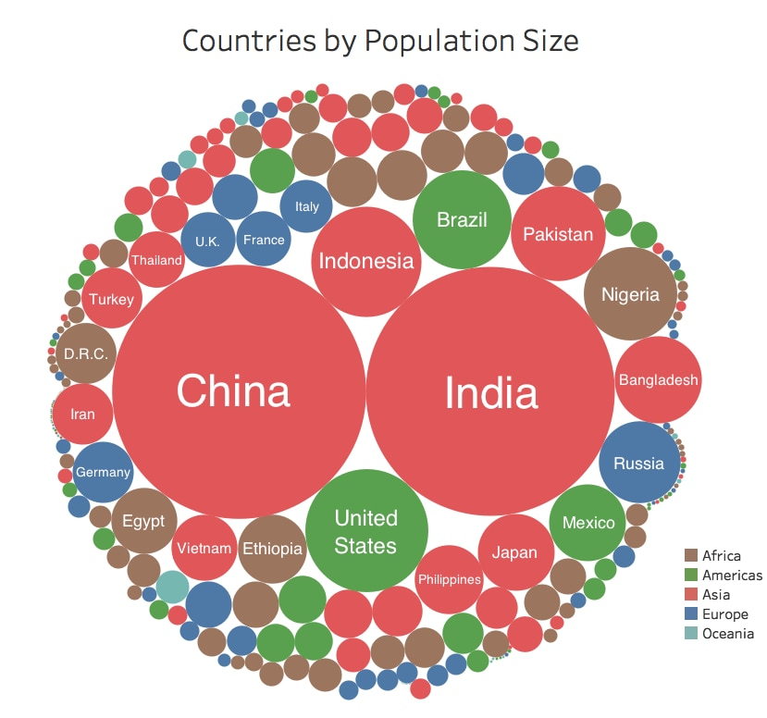
World population: 7 Billion
1+ Billion (China). 1+ Billion (India)
50% of the world’s population live on less than $2.50/day

Slide 25
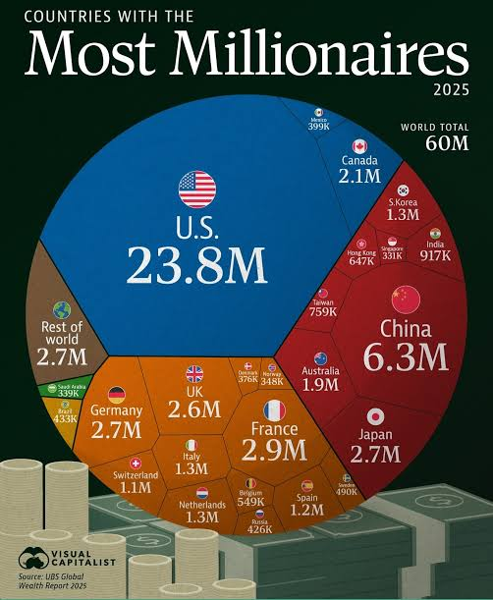

Slide 26
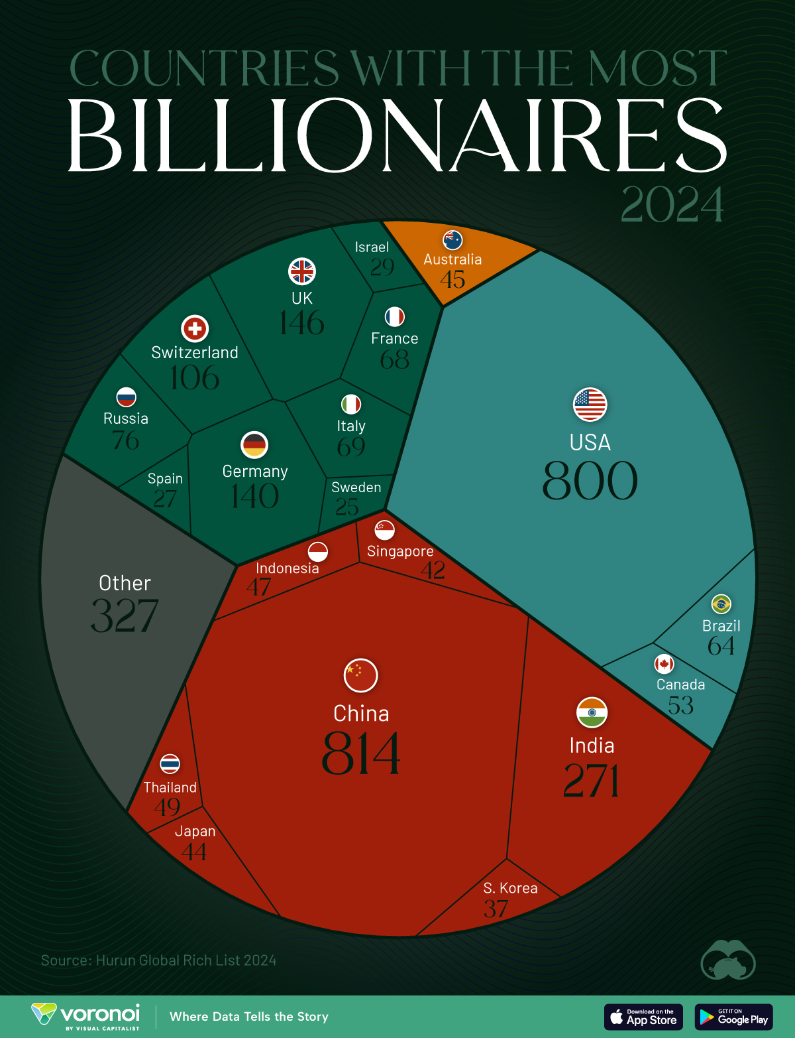

Slide 27
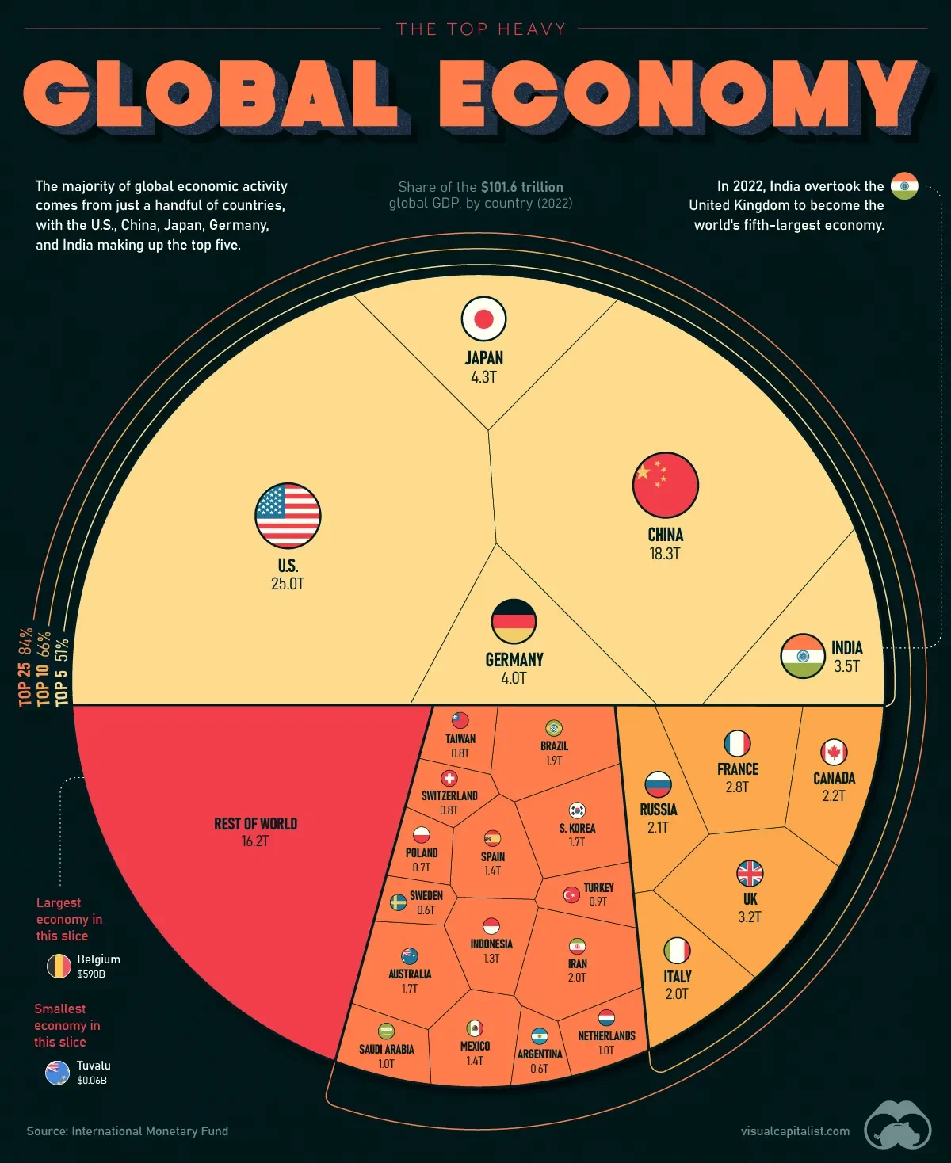

Slide 28
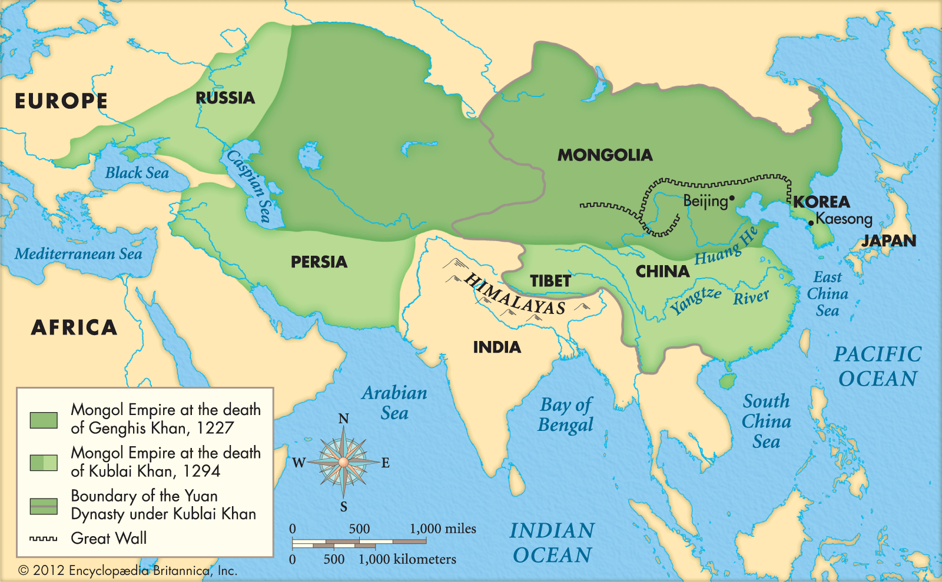

Slide 29
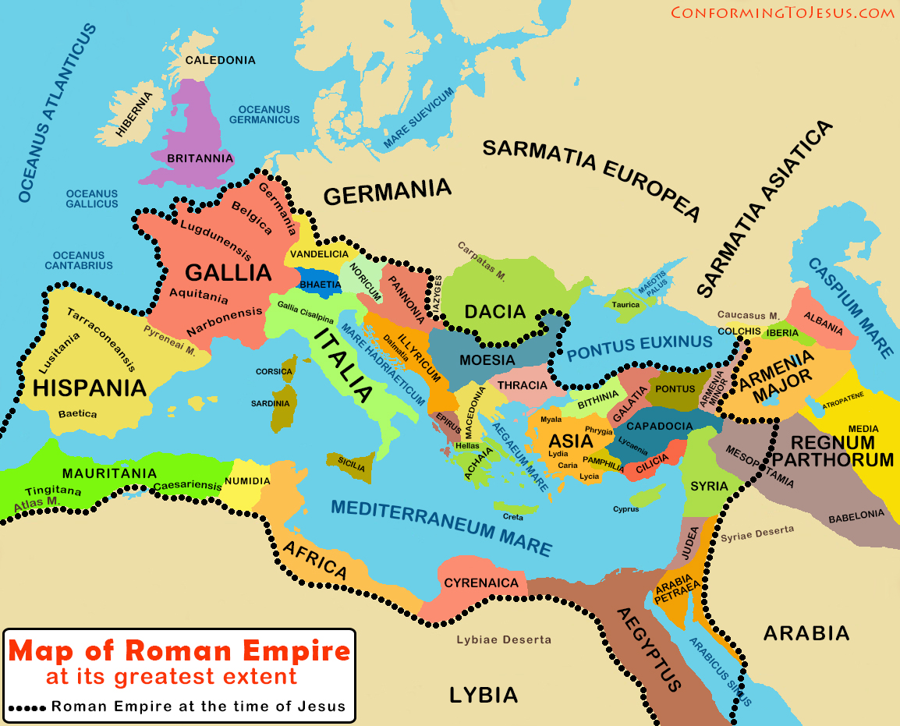

Slide 30
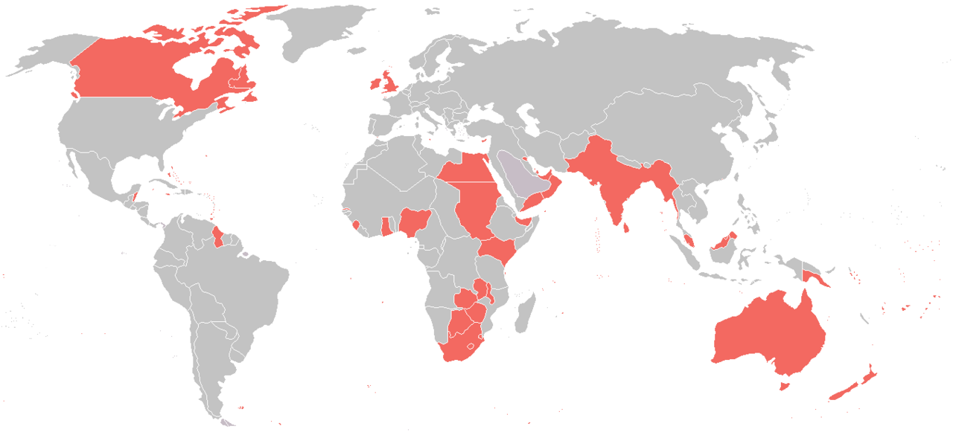
British Empire

Slide 31
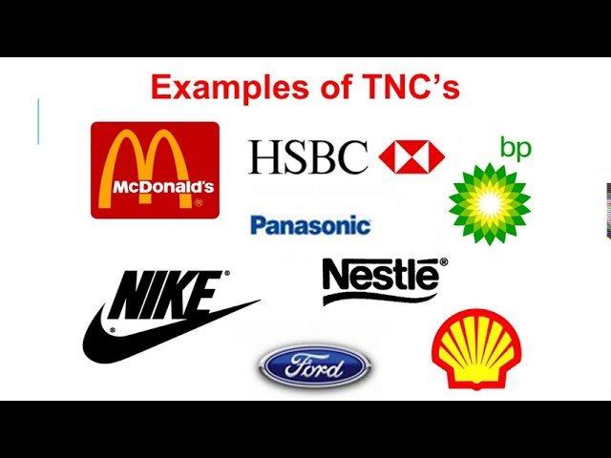

Transnational Corporations
Companies that operate in 2 or more countries

Slide 32


Slide 33

Watch the Walmart movie (slide #9)
Take notes and send them to me today

