Slide 1
Welcome
English Pronunciation Workshop
Class II
Teacher: James Watts
edplus.ca

Slide 2
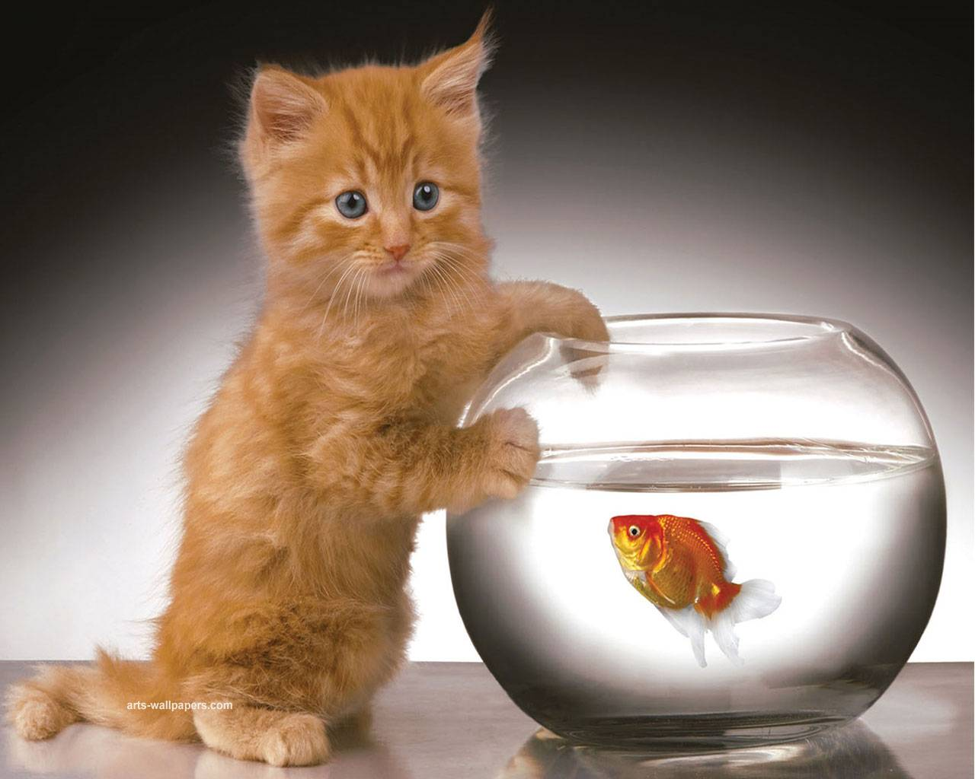

Slide 3
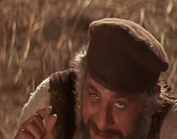
Ask questions
I . . . was/were
I was …. (fact)
When I was younger . . .
If I were …. (imagined)
I wish I were taller.

Slide 4
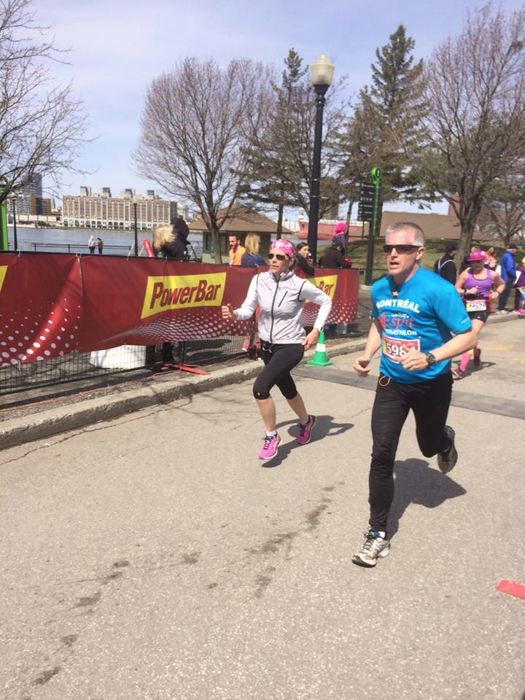

Slide 5
NEWS

Slide 6
You are only learning when you are speaking!

Slide 7
Presentations
Family
Food
Forests
Friends
Fire
Fishing

Slide 8
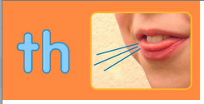
Two TH versions:
The hard sound of the “th” is called “voiced.” The tongue presses and vibrates.
“this,” “there,” and “although”
Their father told
them to think about
their birthday down
south.
The soft sound of the “th” is called “unvoiced.” The tongue presses and breath is forced.
“thank,” “theme,” and “therapy.”

Slide 9
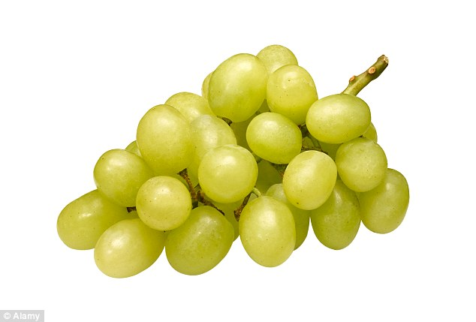
Vowel:
A E I O U …Y
Phoneme:
A unit of sound
Syllable:
A cluster of sounds
with at least
one vowel

Slide 10
The One vowel Rule
If there is only ONE vowel letter in a short word, it is pronounced with its relative vowel sound

Slide 11
1 syllable 1 vowel
Has
Cat
Bed
Men
His
pin
Stop
Up
Tom
Run
Fish
dock

Slide 12
2 Vowel Rule
When a syllable has 2 vowels together, the first vowel is usually long and the second is silent.

Slide 13
1 syllable 2 vowels
Tea
Eat
Place
Suit
Coat
Name
Cute
Time
Ate
Rice

Slide 14
Rules for stress and vowel length
1. In every English word of more than one syllable, one syllable is stressed the most
2. The vowel in the stressed syllable is extra long. E.g. banAna

Slide 15
Which syllable is stressed in the following words?
Sofa
Oven
Painting
London
England
Around
Event
Alberta
Beautiful
Arrange
Brazil
Berlin
Solution
Arrangement
Pollution
Atlanta
Horrible
Energy

Slide 16
Interviews

Slide 17
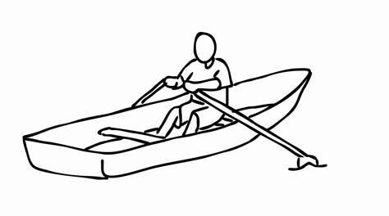
Ethical dilemma
$5.00
THELMA
FRED
PATRICK
STEVE
DONALD

Slide 18
Restaurant

