Slide 1
Women’s day 2017

Slide 2
You are only learning when you are speaking!

Slide 3
Presentations
My country . . .

Slide 4
Family

Slide 5
Hangman

Slide 6
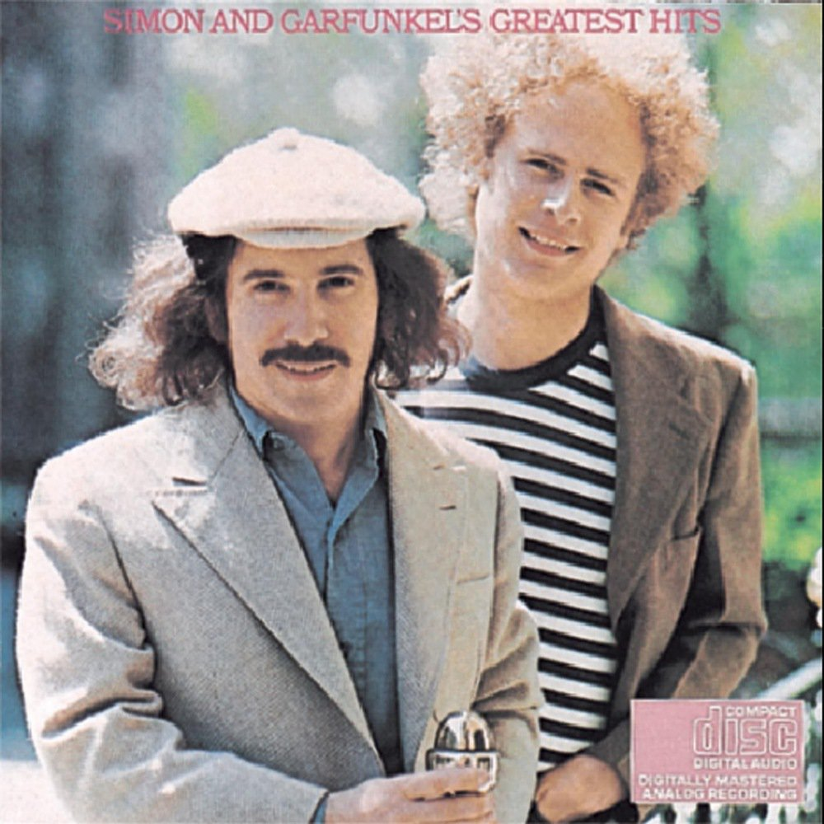
Paul Simon and Art Garfunkel

Slide 7
The sound of silence
Darkness
Vision
Creeping (creep)
Seeds – planted
Brain
Restless
Dreams
Cobblestone
Halo
Collar
Damp
Neon light
Naked light
Dared
Cancer
Raindrops
Echo
Well
Bow
Warning
Prophets
Subway
Tenement
Whisper

Slide 8
