Slide 1
History of québec and Canada
RECAP OF SECONDARY III CONTENT

Slide 2
Origins to 1608
The experience of the Indigenous peoples and the colonization attempts

Slide 3
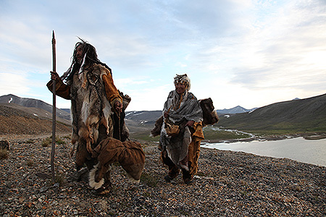
Origins to 1608

Slide 4
Origins to 1608
Having reached North America well before the French, the Aboriginal peoples developed many survival techniques adapted to the distinctive features of this continent.
Circa 1500, the lives of First Nation peoples were disrupted by the arrival of Europeans. Indeed, during the course of a century, these Europeans led various voyages of exploration in the hope of finding riches in this new world.
Intrigued by this continent viewed as wild, different kings of France even attempted to colonize it. This reality drove the French and the Aboriginal peoples to interact evermore increasingly, thus definitively transforming each group’s way of life.

Slide 5
First occupants of the territory
How did human beings reach the American continent?

Slide 6
MULTIPLE CHOICE QUESTION
According to the Bering land bridge migration theory, what continent did the nomads who originally settled northeastern America come from?
Africa
Asia
Europe

Slide 7
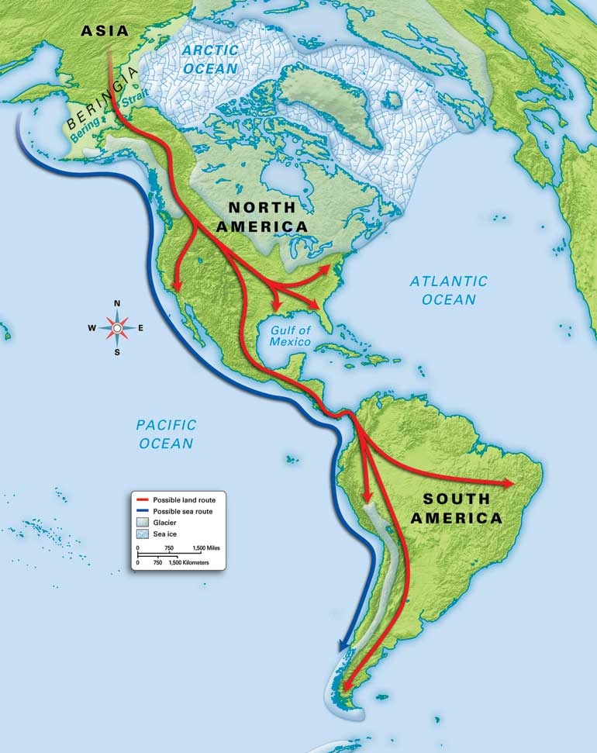
The first inhabitants of North America most likely arrived from Asia via Beringia.
Vast migration across America.
At least 30,000 years ago!

Slide 8
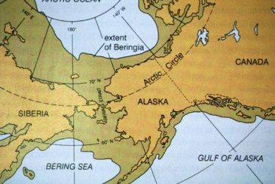

Slide 9
The 3 major linguistic groups
Inuit
First Nations
Algonquian
Iroquoian

Slide 10
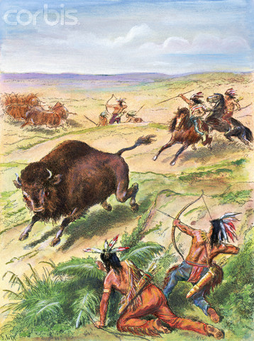
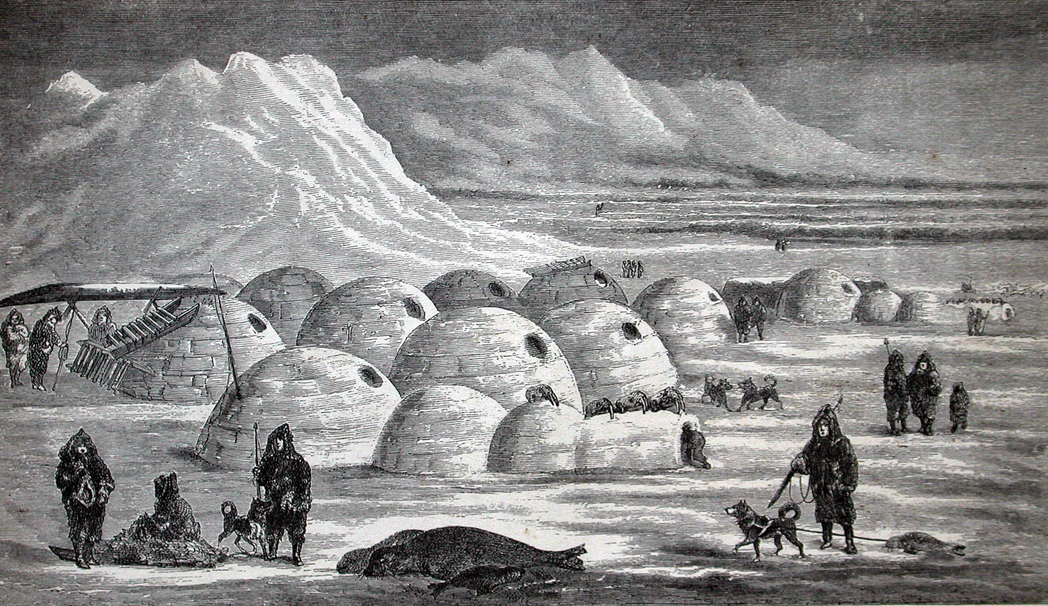
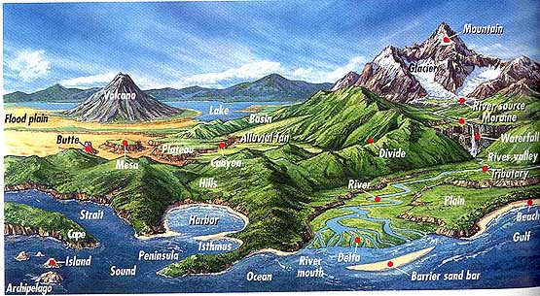
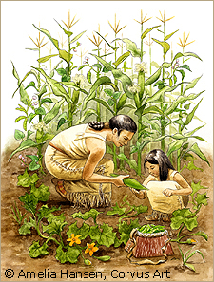
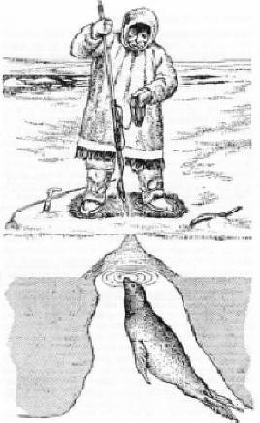
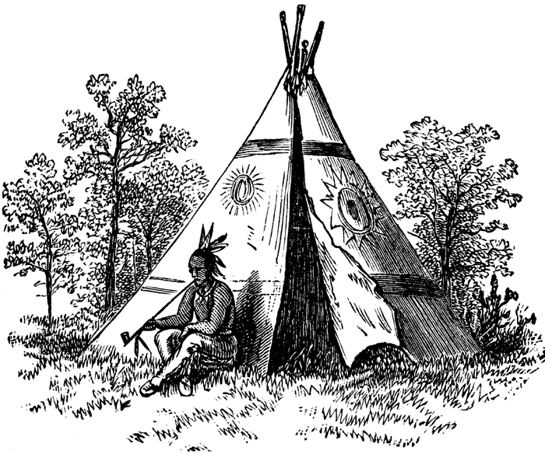
Climate and resources found on their land
ADAPTATION
WAY OF LIFE

Slide 11
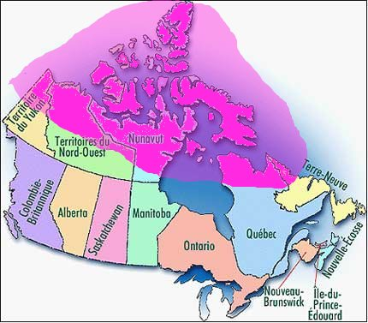
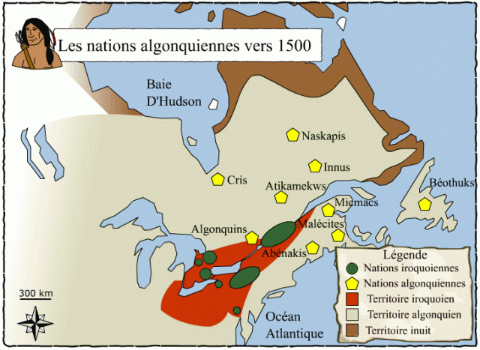
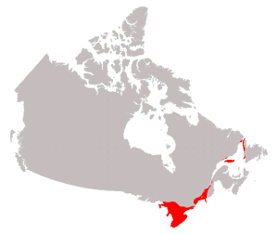
1- Territory
The Inuit
(“The People”)
The Algonquians
The Iroquois
North American Arctic: Alaska, Northwest Territories, Nunavut, northern Québec, and Labrador (also Greenland)
Appalachians (mountains) and Canadian Shield (plateau) in QC, ON and northeastern USA) – unfertile land
St. Lawrence Lowlands and the Great Lakes (plains) in upper NY State, southern ON and southwestern QC – fertile land

Slide 12
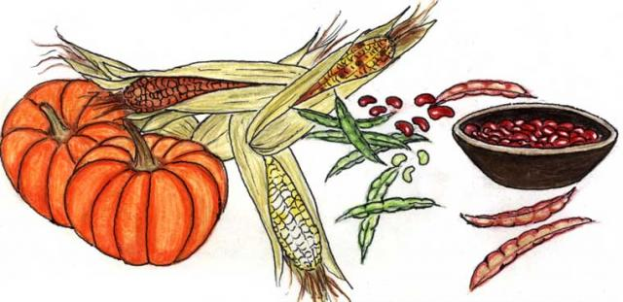
2- Economy / subsistence activities
The Inuit | The Algonquians | The Iroquois
Hunting Seal Whale Caribou Etc. Fishing Gathering | Hunting Fishing Gathering | Agriculture Corn Squash Beans Hunting Fishing Gathering

Slide 13
3- Way of life
The Inuit | The Algonquians | The Iroquois
Nomadic Moved camp site often in search of food on their territory (seasons) | Nomadic | Sedentary Remained in the same place 8-15 years until surrounding fields became unfertile

Slide 14
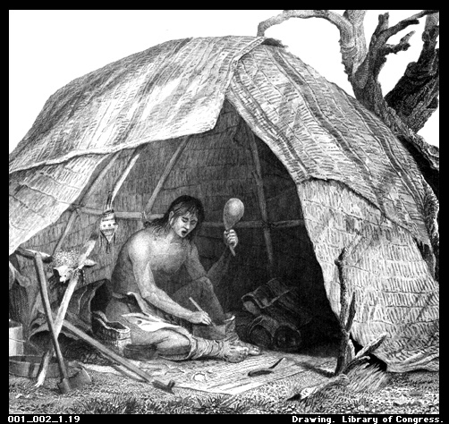
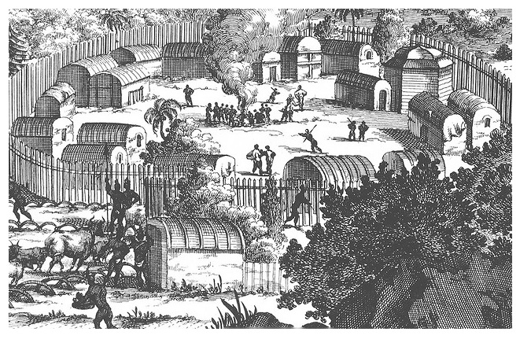
4- Dwelling (home)
The Inuit | The Algonquians | The Iroquois
Igloos in winter Animal skin tents in summer | Wigwam (bark or animal skin tent) | Longhouse (palisaded village on fertile land close to a body of water and forest)

Slide 15
5- Social group responsible for the primary subsistence activity
The Inuit | The Algonquians | The Iroquois
Men | Men | Women

Slide 16
6- Type of society
The Inuit | The Algonquians | The Iroquois
Patrilineal (father is head of the family) | Patrilineal | Matrilineal (mother is head of the family)

Slide 17
7- Population
The Inuit | The Algonquians | The Iroquois
Bands of 12 to 15 people in winter Bands of 100 people in summer | Bands of 12 to 15 people in winter Bands of 100 to 300 people in summer | Villages of 300 to 2,000 people

Slide 18
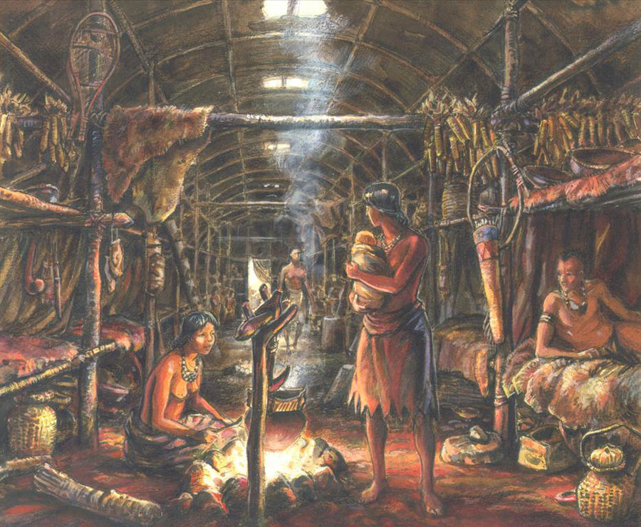
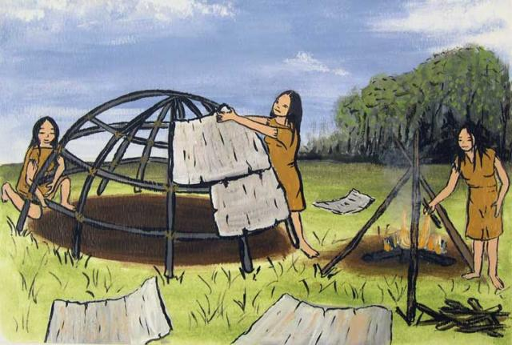
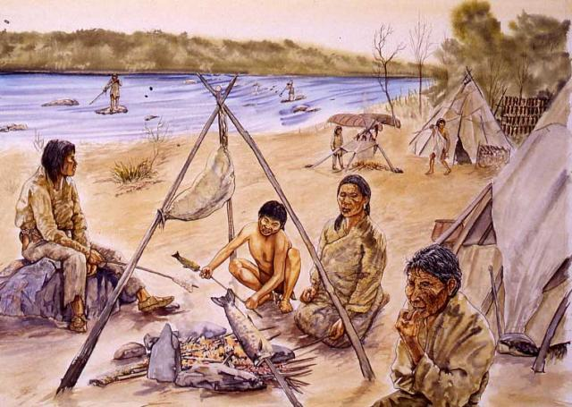
Subsitence economy (self-sufficient)

Slide 19
Indigenous trade networks

Slide 20
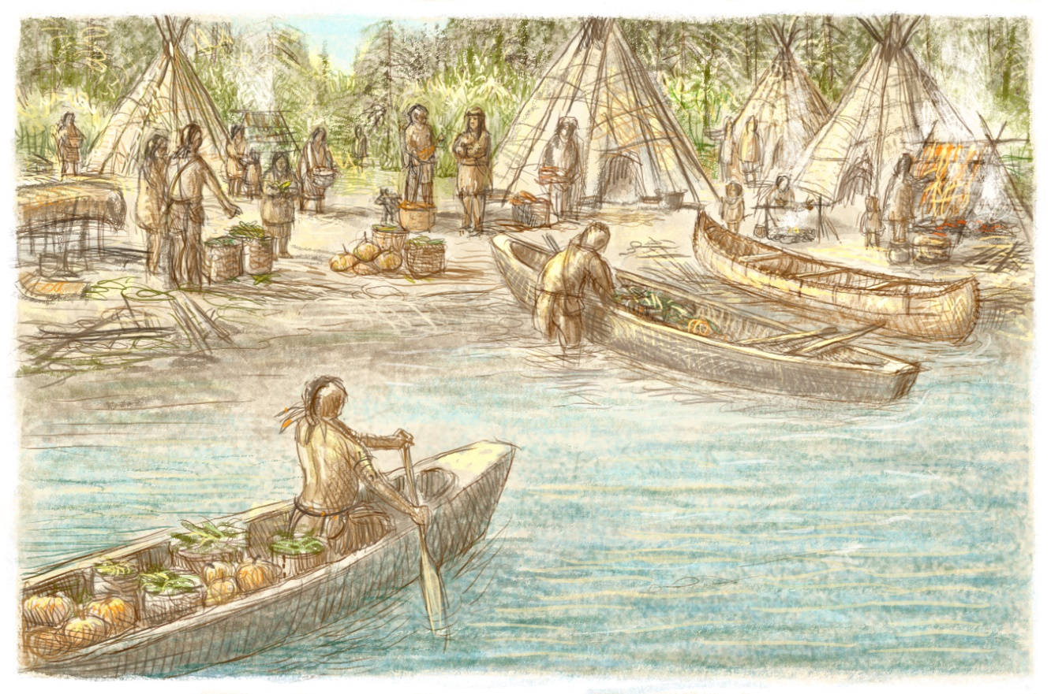

TRUE or FALSE QUESTION
The Aboriginal peoples used Bitcoins as a means of exchange for goods (trade).

Slide 21

Barter

Slide 22
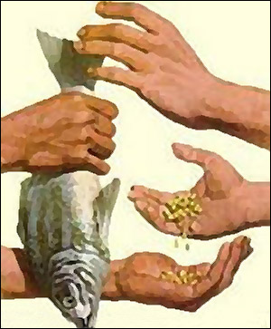
Iroquoian nations traded their corn for meat and furs from the Algonquian nations.
Vast trade network across the continent.
Goods were transported by canoe (use of waterways) and also on foot, with snowshoes in winter.

Slide 23
Social relations among Indigenous peoples

Slide 24
Important values
Equality
Liberty
Sharing
  No private land ownership
  Practice of gift and counter-gift (moral duty; generosity; mutual aid)
Respect for nature (needed to live in harmony with their environment to survive)

Slide 25
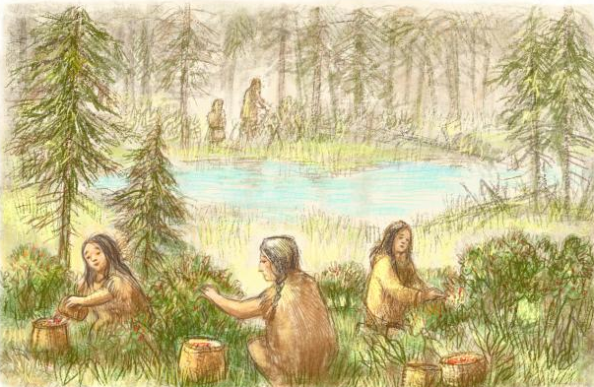
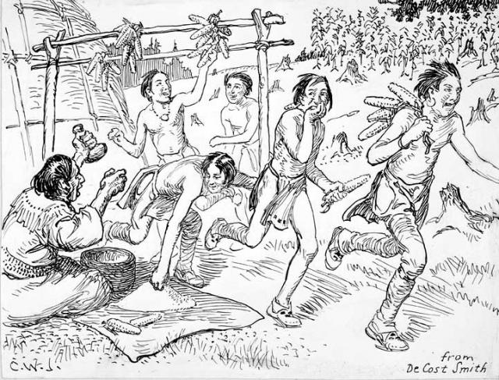
Child-rearing
Children educated freely by the community
No punishment, they learned from their mistakes
When old enough, they would be taught different tasks from adults of the same gender

Slide 26
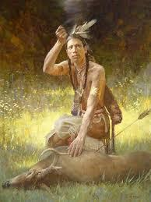
MULTIPLE CHOICE QUESTION
This drawing presents a cultural activity related to the spirituality of the Aboriginal peoples.
On what belief is this cultural activity based?
Judaism
Animism
Catholicism

Slide 27
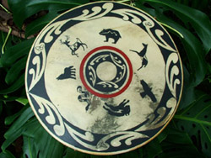
Spirituality
Animism

Slide 28
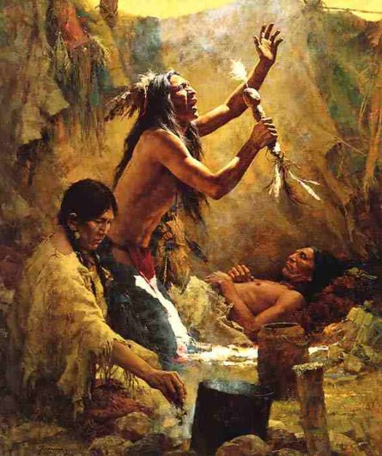
QUESTION
Identify one role played by the shaman in the ceremonies or rituals of the Aboriginal peoples.

Slide 29
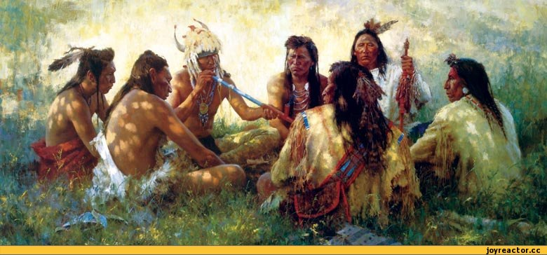
Shaman
Intermediary between the living and the spirits
Healer of body and soul
Interpreter of dreams

Slide 30
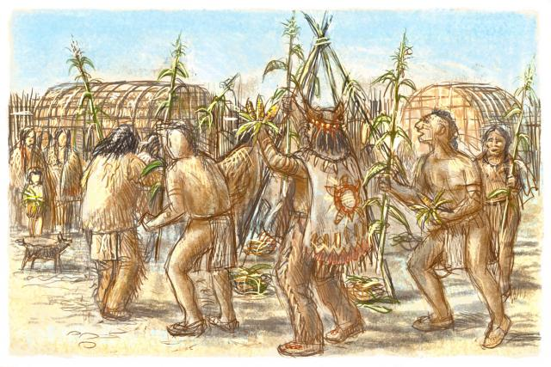
Spirituality
Rituals
(e.g. a corn ceremony)

Slide 31
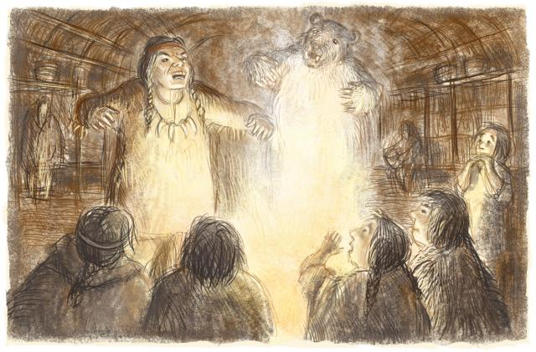
QUESTION
What is the main difference between Indigenous and European ways of life in the 16th century concerning the transmission of knowledge?

Slide 32
Oral tradition and the importance of elders

Slide 33
Decision-making among Indigenous peoples

Slide 34
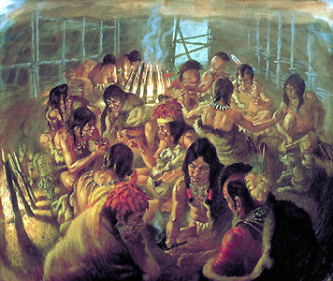
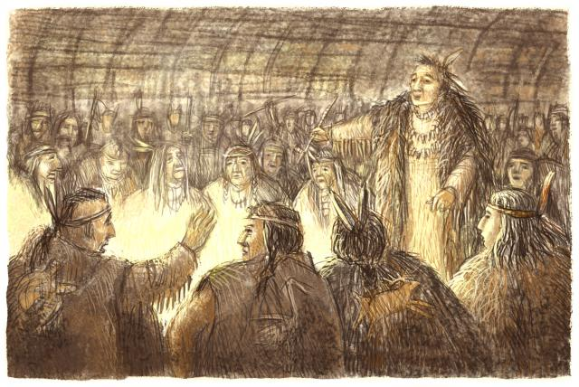
Decisions made by a council.
The chief :
would advise the council
example for the community.
Algonquian peoples
Chief chosen among bravest hunters.
Iroquoian peoples
Clan chief chosen by female elders.

Slide 35
First Nations alliances and rivalries

Slide 36
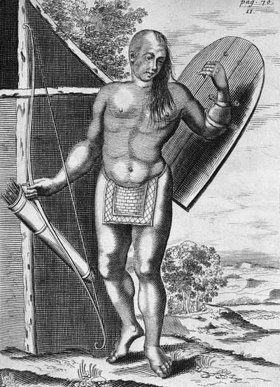
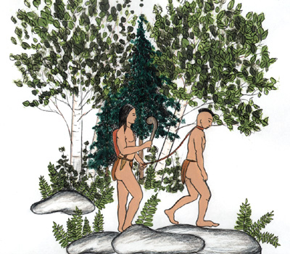
Alliances
Economic reason
  Exchange goods
Military reason
  Help defend nations in case of conflict.
Wars
Vengence after a death from accident, illness or a previous conflict.
Prisoners were sometimes tortured or adopted by the group that captured them.

Slide 37
QUESTION
Place these 4 events in chronological order.

Slide 38
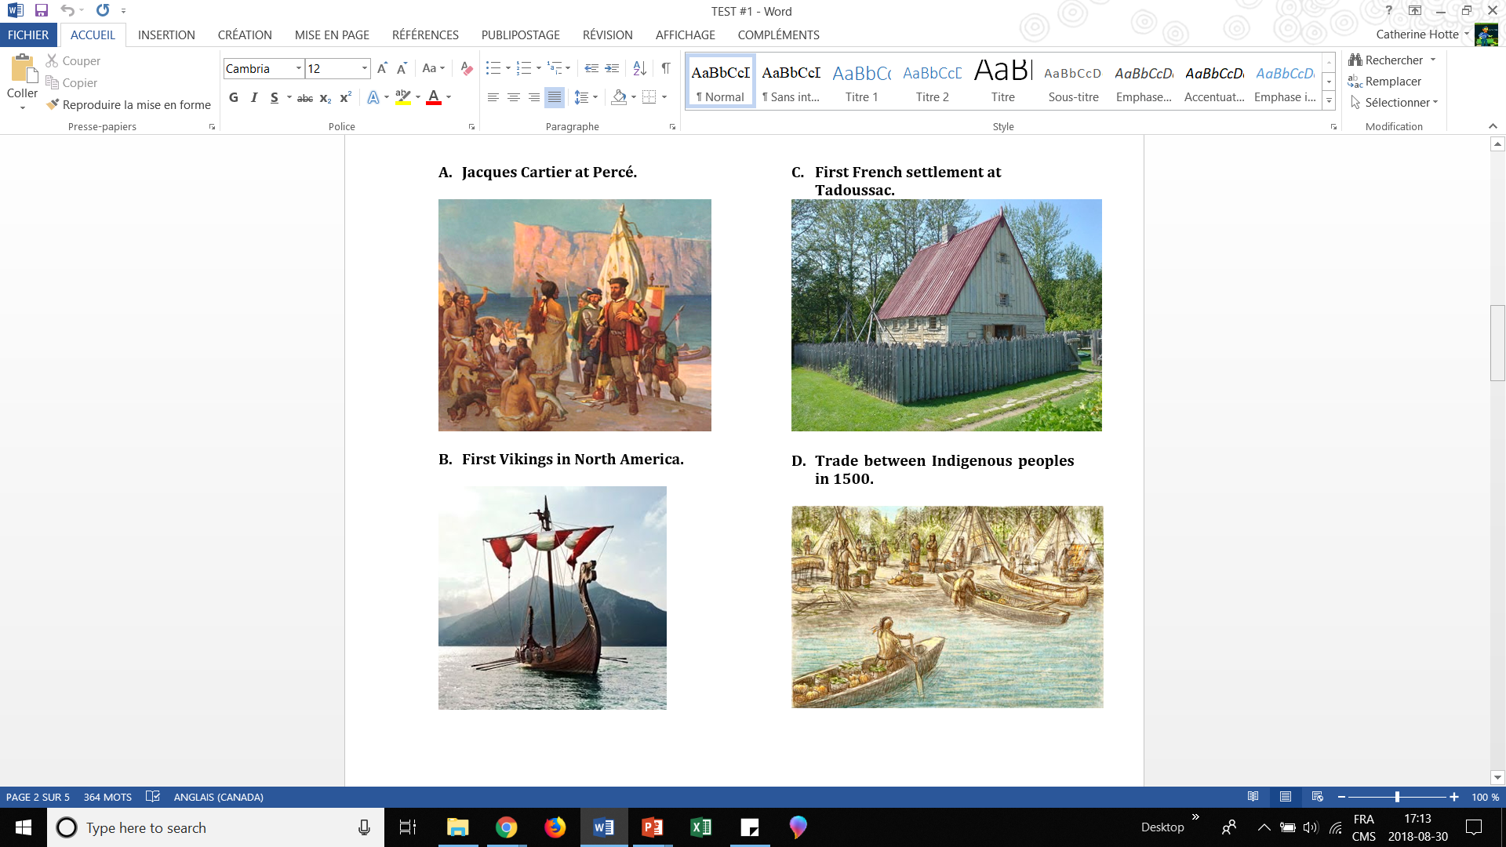
Place these 4 events in chronological order.

Slide 39
ANSWER

Slide 40
First contacts

Slide 41
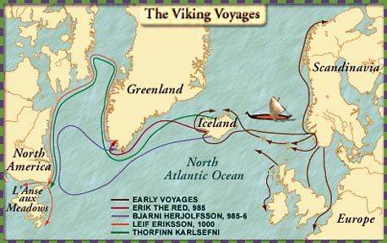

Slide 42
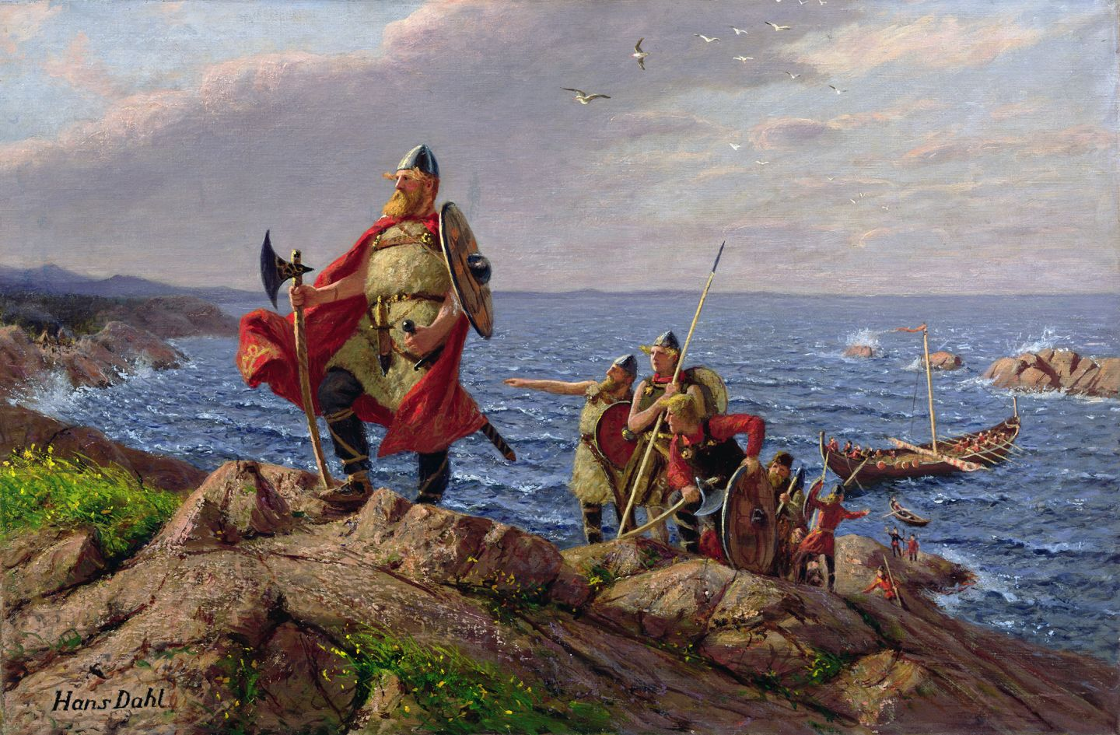

Slide 43
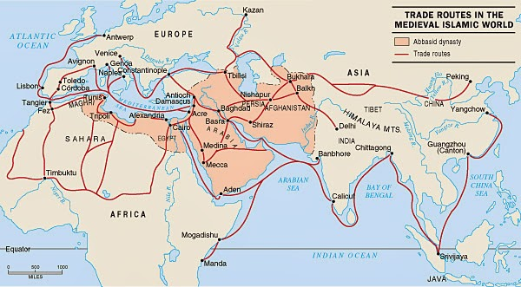

Slide 44
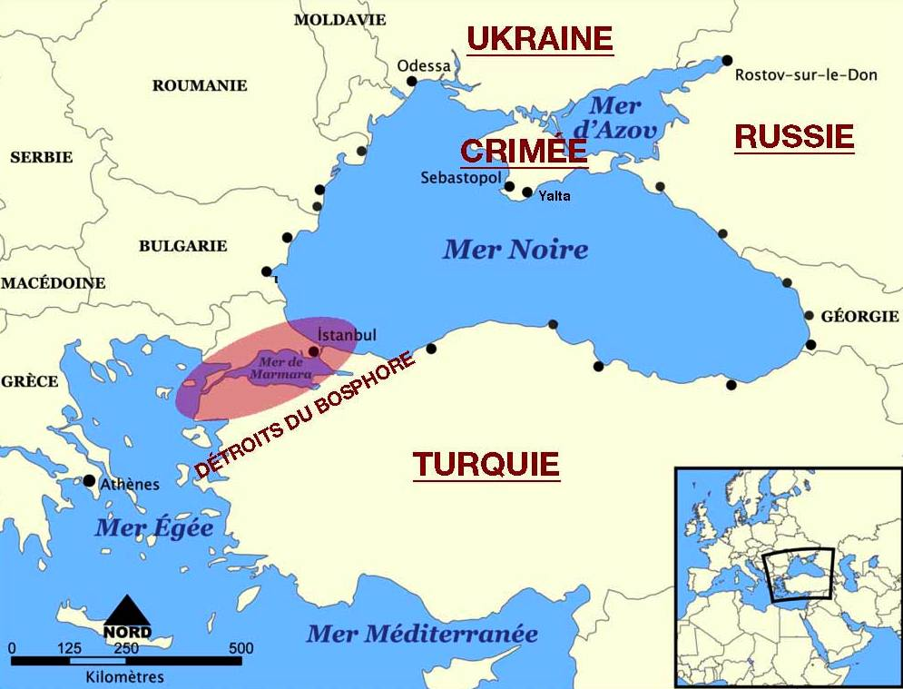
Fall of Constantinople (1453)

Slide 45
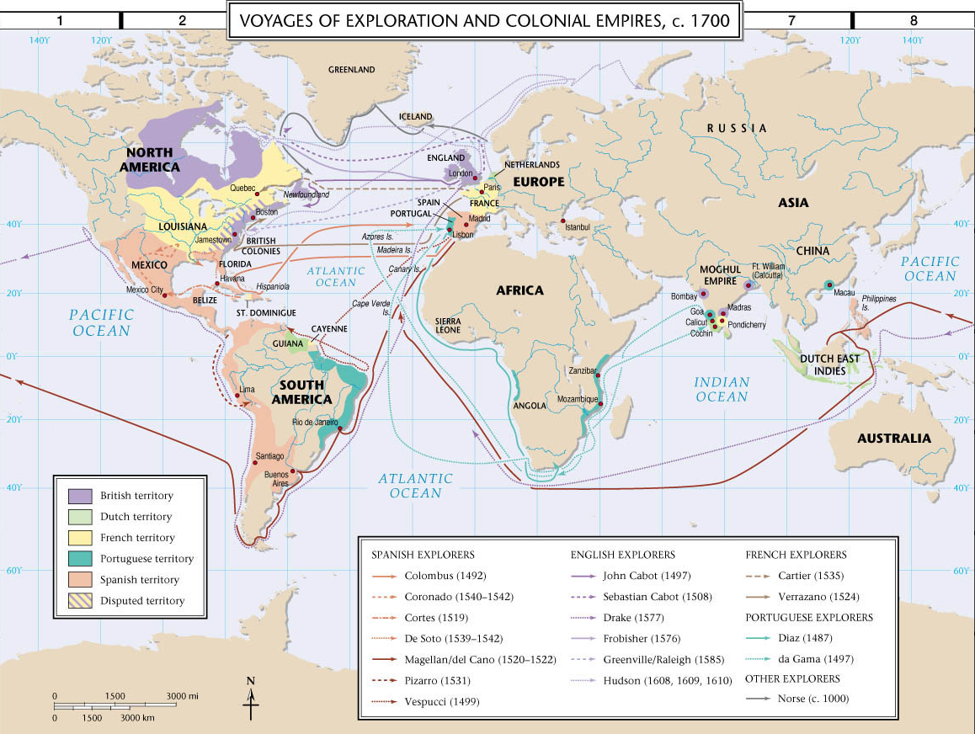
Renaissance (1300-1600)
Voyages of European explorers to find a new route to Asia so as to gain wealth.

Slide 47
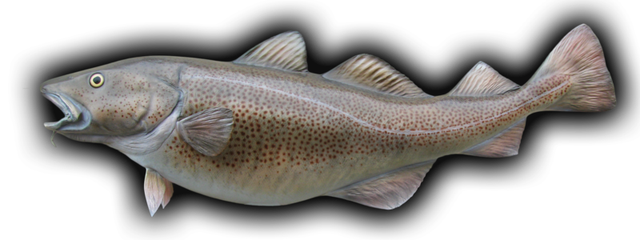
MULTIPLE CHOICE QUESTION
What was the first natural resource that Europeans exploited in North America?
Marijuana
Furs
Fish

Slide 48
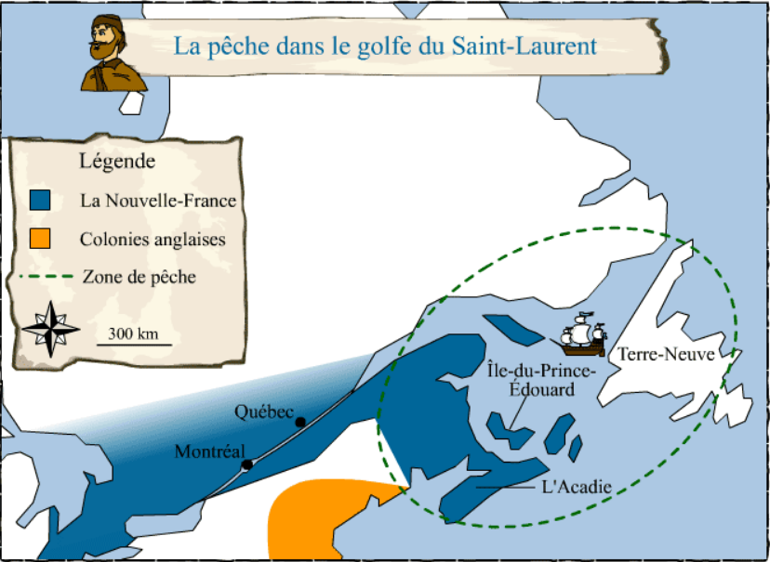
Europeans fishing and whaling in the Gulf of St. Lawrence (end of 15th century)

Slide 49
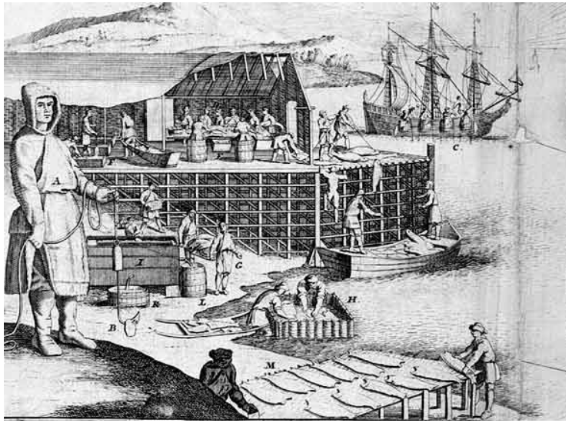
Cod fishing in the Gulf of St. Lawrence
(end of 15th century)

Slide 50
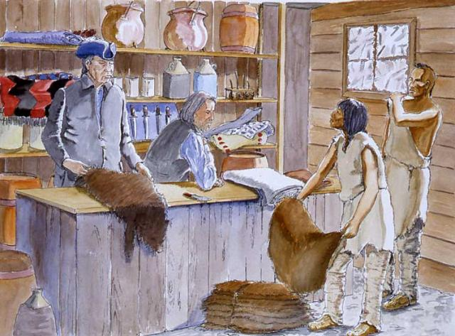
Trade between Europeans and Aboriginals
(end of 15th century)

Slide 51
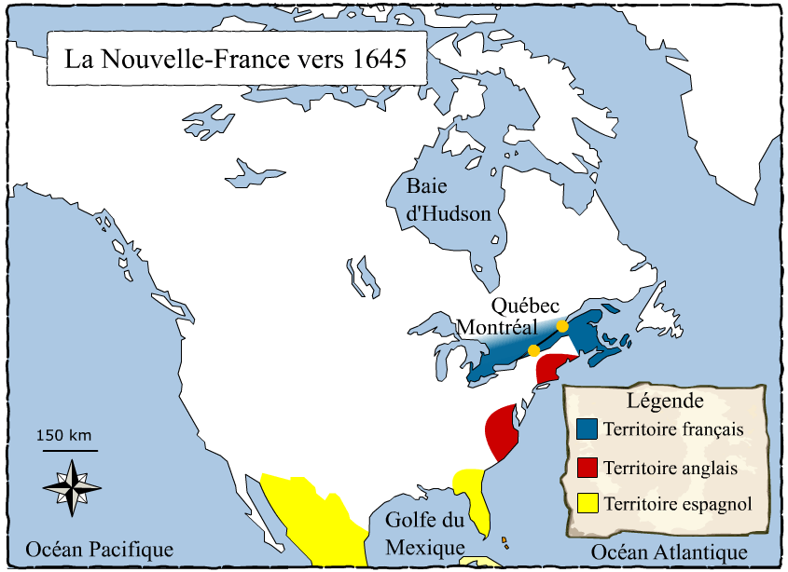
Trading contributed to the first European explorations of North America in the 16th century.

Slide 52
French exploration and occupation of the territory

Slide 53
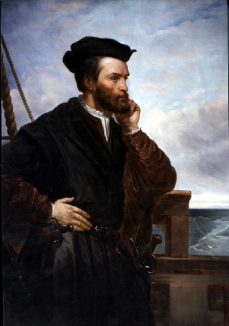
Jacques Cartier (French explorer)

Slide 54
TRUE or FALSE QUESTION
One of Jacques Cartier’s contributions to European knowledge of northeastern North America was the discovery of a route to Asia.
FALSE!

Slide 55
TRUE or FALSE QUESTION
One of Jacques Cartier’s contributions to European knowledge of northeastern North America was the discovery of lots of gold and riches.
FALSE!

Slide 56
TRUE or FALSE QUESTION
One of Jacques Cartier’s contributions to European knowledge of northeastern North America was the exploration and mapping out of the Gulf and Valley of St. Lawrence.
TRUE!

Slide 57
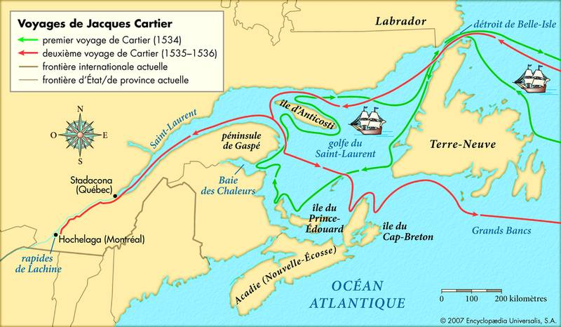
The 3 voyages of Jacques Cartier to Canada
(1534-1542)

Slide 58
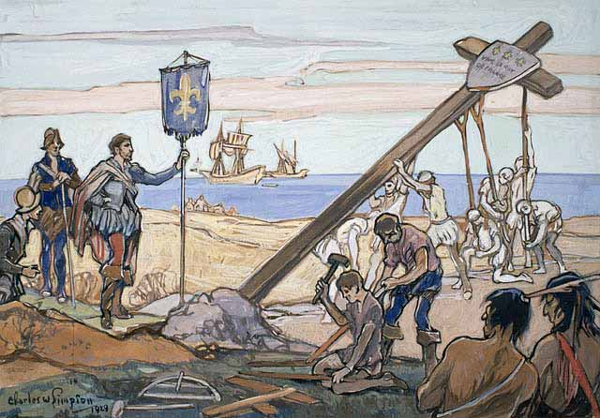

Slide 59
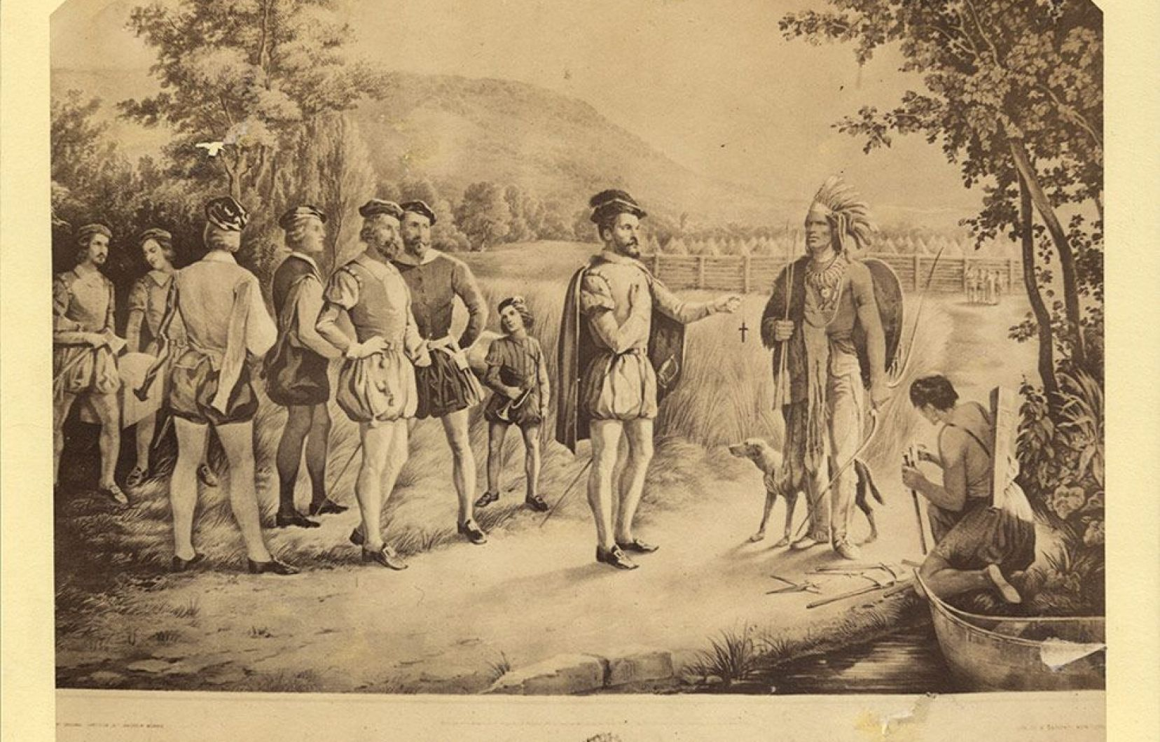
Representation of Jacques Cartier meeting Hochelaga Aboriginals in 1535.

Slide 60
Jacques Cartier (France):
  After 2 voyages:
    Failed to find a route to Asia
    Failed to find gold and riches
    Explored and mapped out the Gulf of St. Lawrence and the St. Lawrence Valley
    Claimed land in the name of the king of Francis I (zone of French influence)
    Made contact with the native population
    Located valuable resources
    Attempted to establish a colony.

Slide 61
4 valuable resources found by Jacques Cartier in New France:
Fish
Furs
Forests (timber)
Farming (arable land / soil suitable for agriculture)

Slide 62
Fish
(abundant schools of cod)

Slide 63
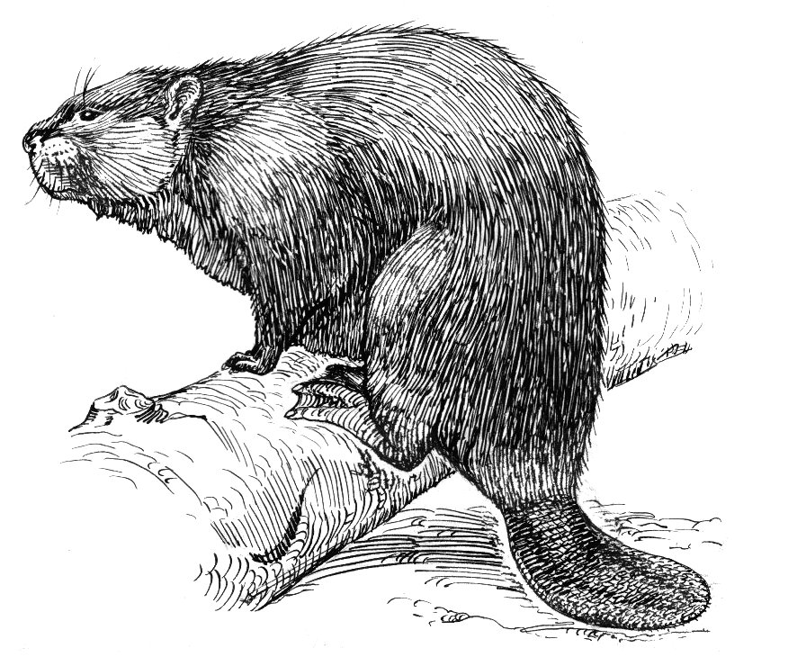
Furs
($$$)

Slide 64
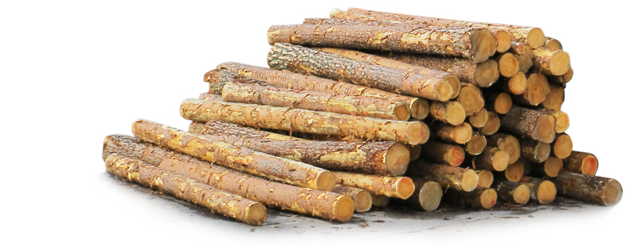
Forests
(timber)

Slide 65
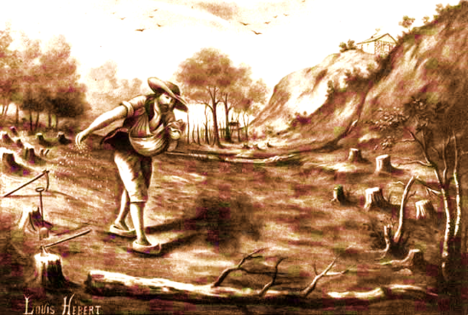
Farming
(arable land / soil suitable for agriculture)

Slide 66


The first French settlements some 60 years later
Tadoussac (1600-1610):

Slide 67

Port-Royal, Acadia (1605-1607):

Slide 68

The French and the Amerindians came into contact:
They bartered furs for trade goods (guns, metal goods, cloth, brandy, etc.)
French missionaries wanted to convert the Natives to Christianity.

Slide 69


Slide 70

Coureurs des bois / voyageurs

Slide 71


Slide 72


Slide 73

European diseases
depleted Amerindian populations

Slide 74
Franco-Aboriginal Alliance of 1603
Important economic and military alliance between Indigenous peoples and the French (Champlain present) in Tadoussac.
Would strengthen the Innu, Maliseet and Algonquins’ military power against the Iroquois. It marked the beginning of vast changes to their cultures and territories.
The French became officially the enemy of the Iroquois Confederacy.
This pact fostered the development of the fur trade and the establishment of a permanent colony in Canada.

