Slide 1

Welcome
English Pronunciation Workshop
Class 4
Teacher: James Watts
edplus.ca

Slide 2

Ask questions

Slide 3
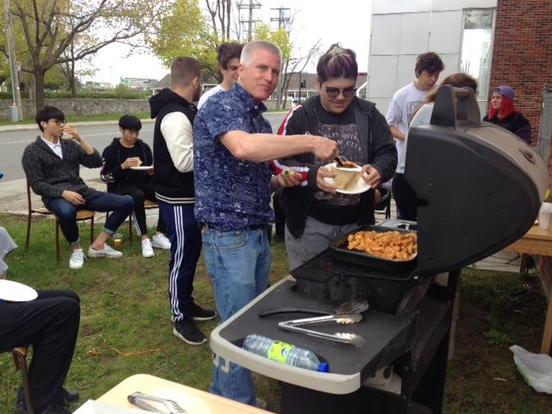

Slide 4
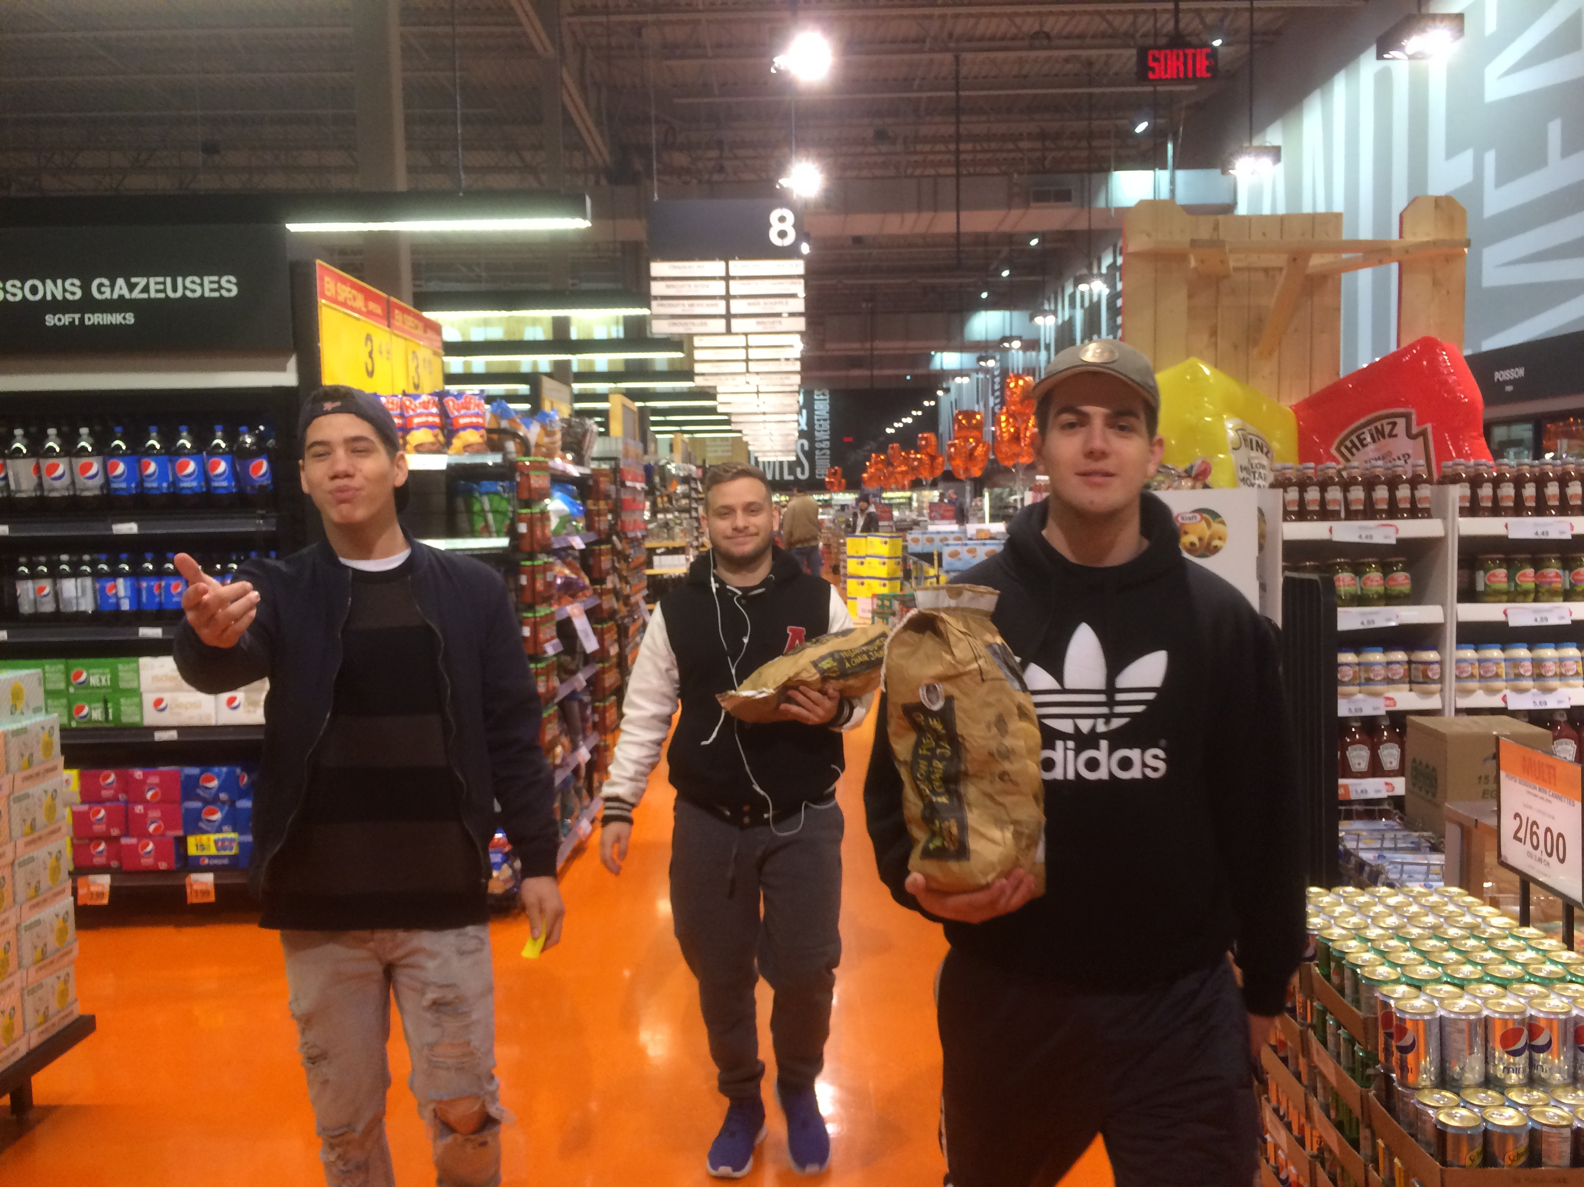
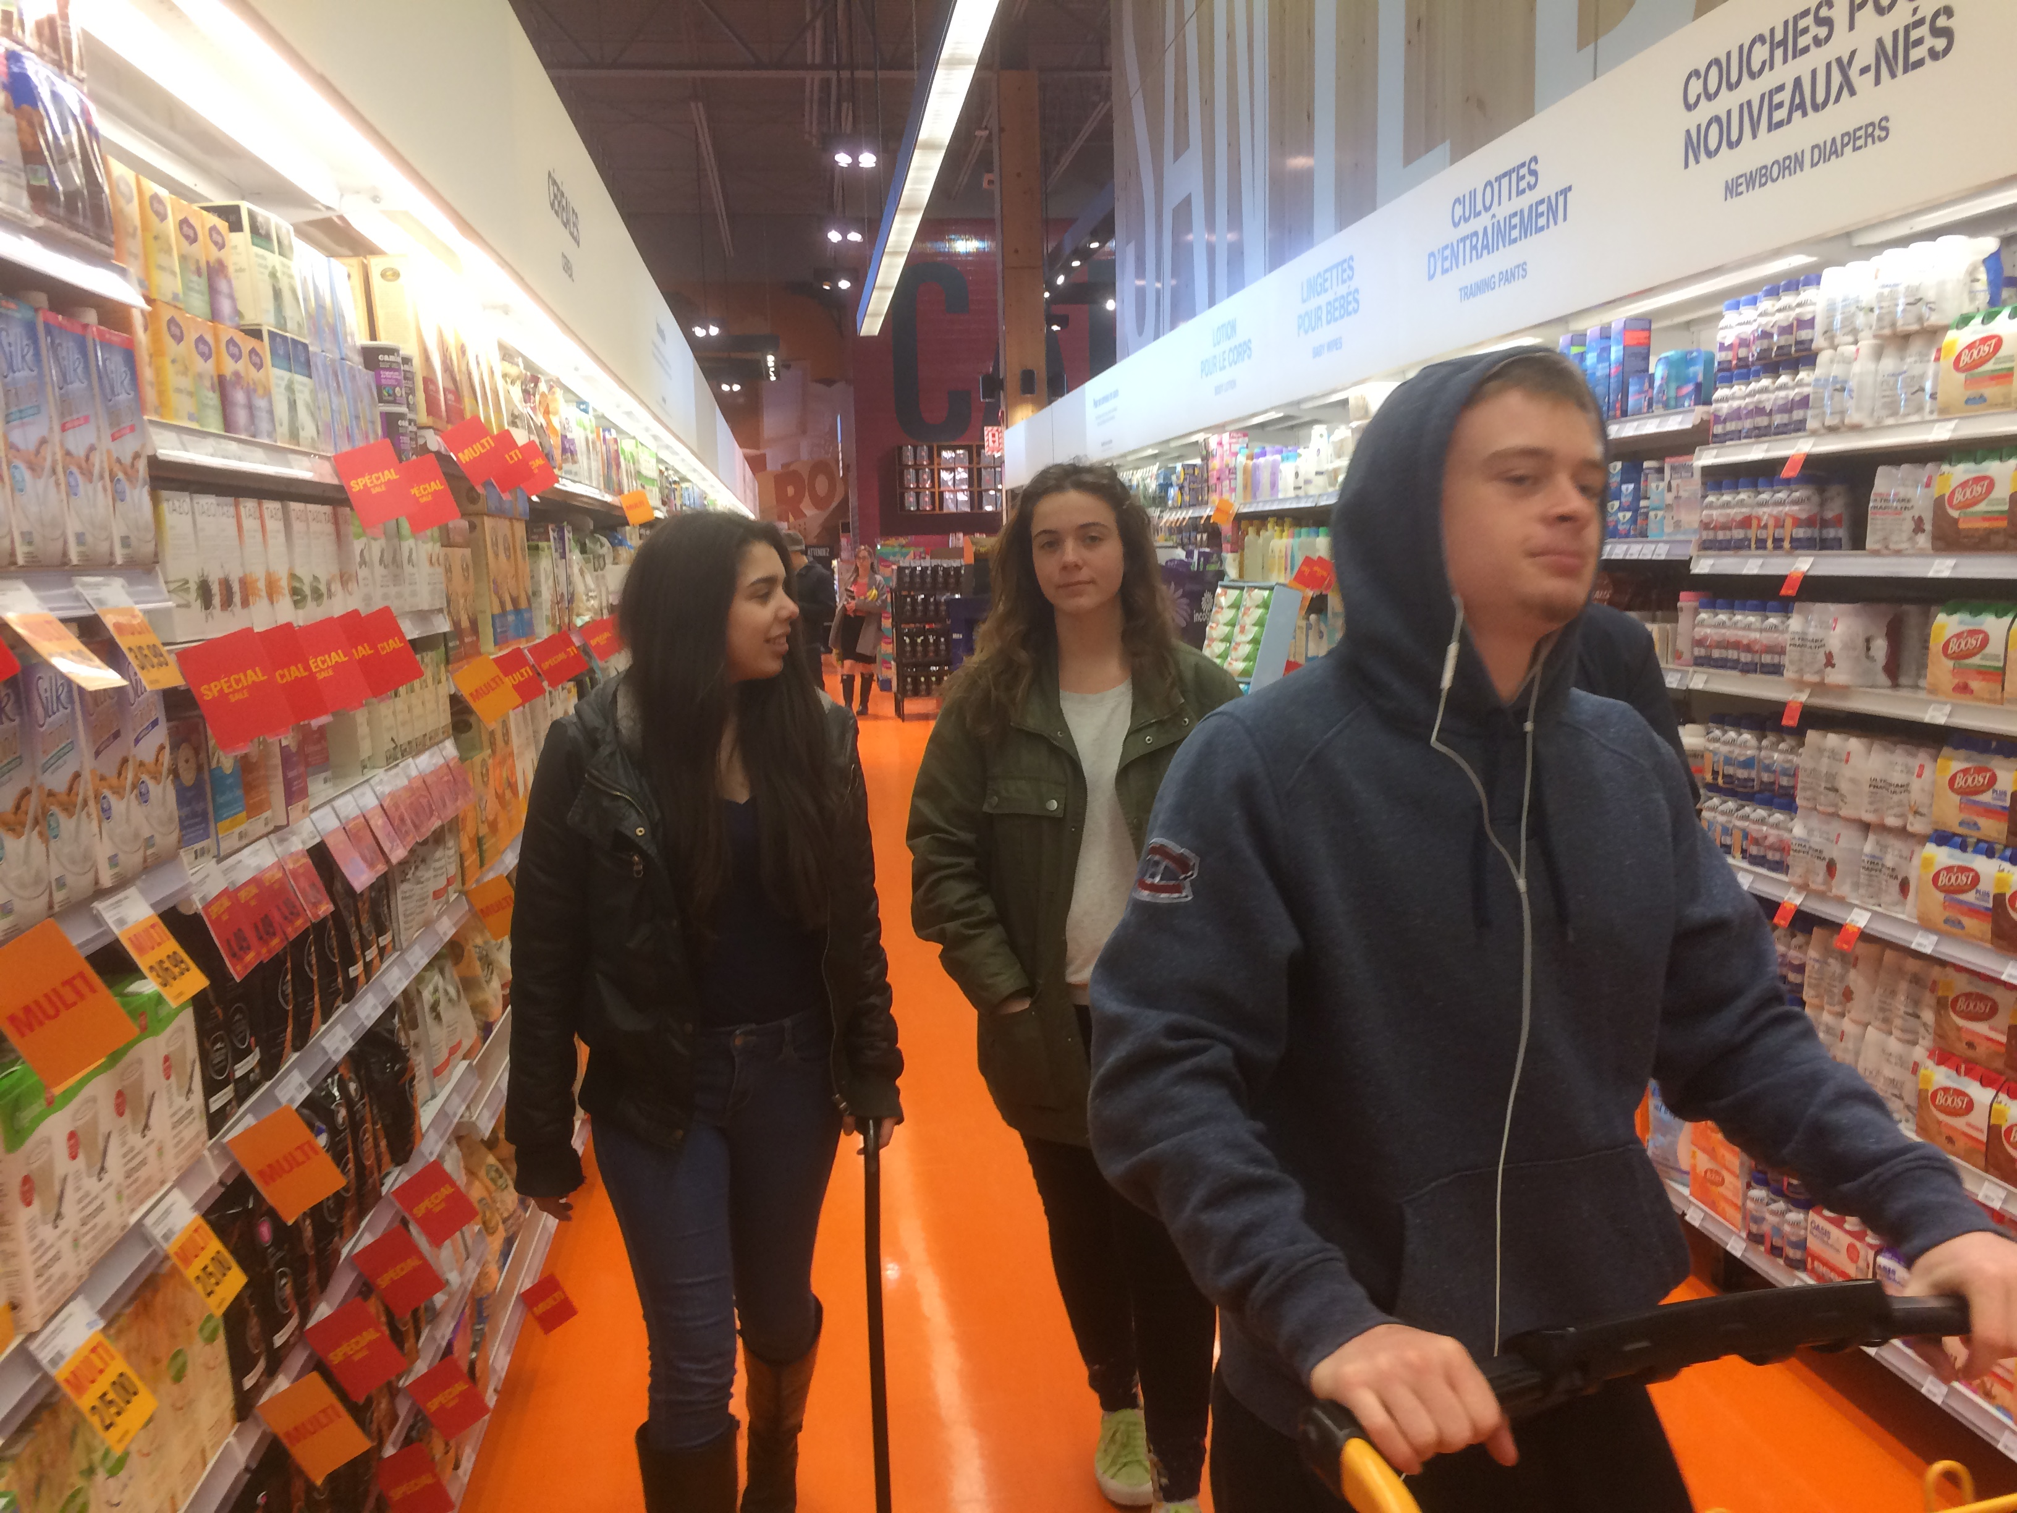
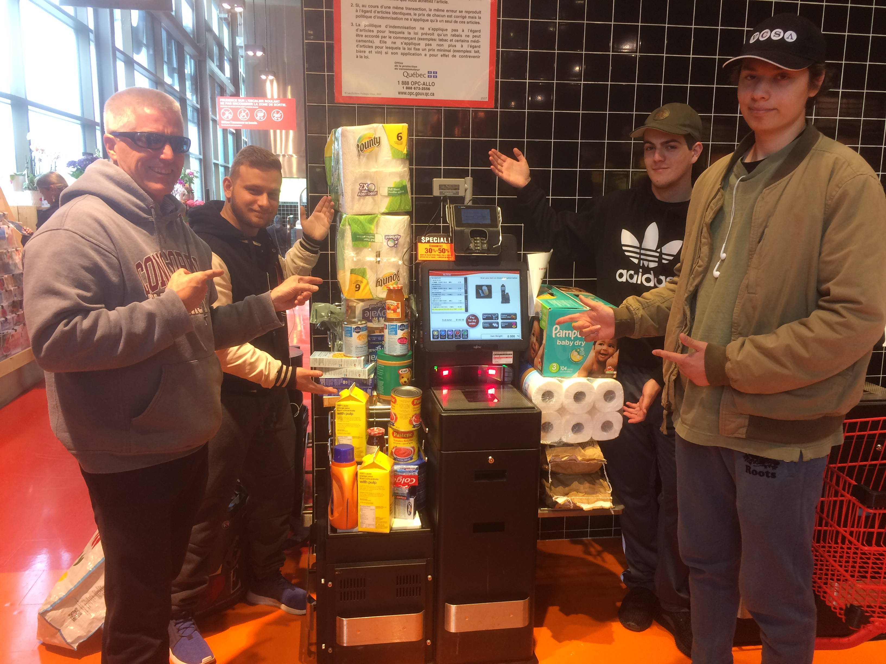

Slide 5
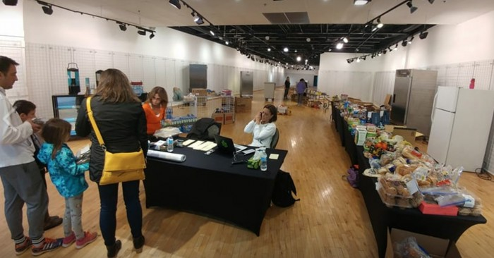
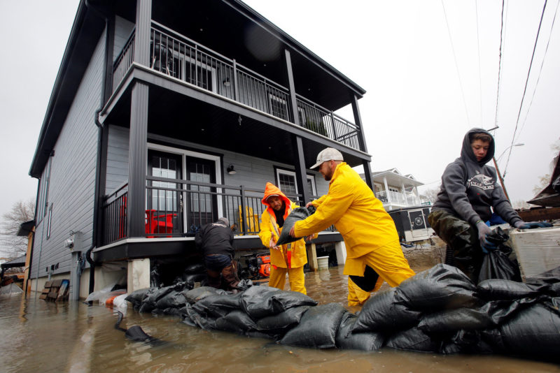

Slide 6


Slide 7
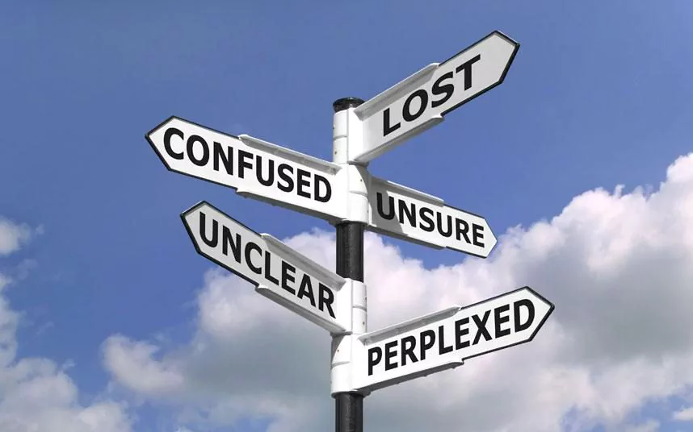
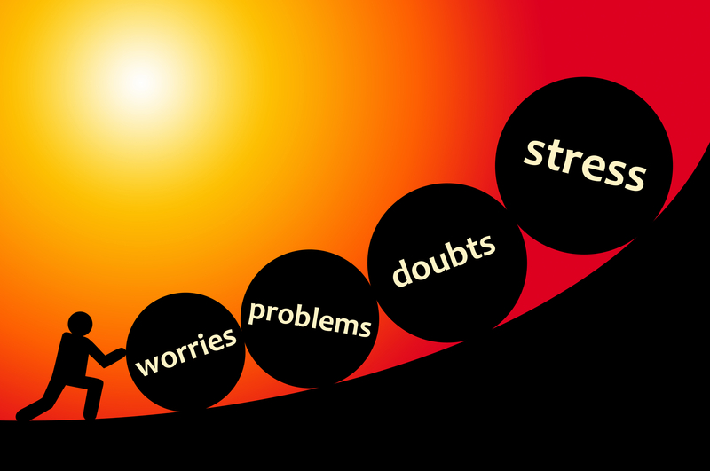

Do you think young people not as resilient as previous generations?

Slide 8
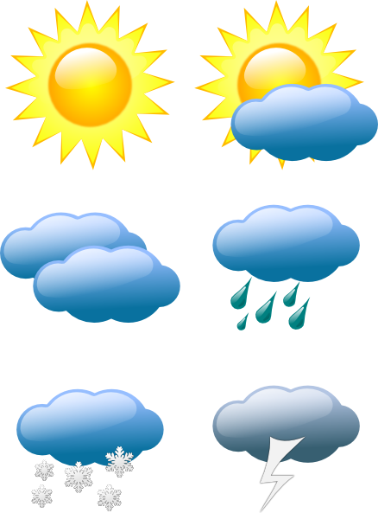
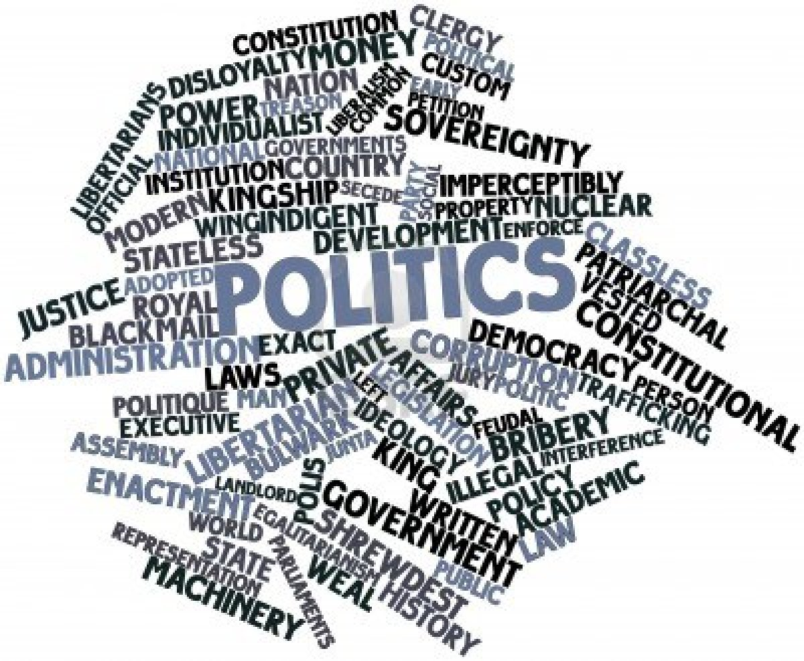


NEWS

Slide 9

You are only learning when you are speaking!

Slide 10

Presentations
My best friend . . .
My hero ….
My happy place ….
My worst injury ….
My first love ….

Slide 11

Next week
Presentations . . .

Slide 12
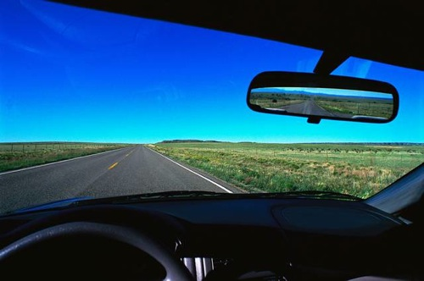
Irregular past tense verbs

Slide 13
Prepositions
Place
in
at
on
by, next to, beside
under
below
over
above
across
through
to
into
towards
onto
from
Time
on
in
at
by

Slide 14
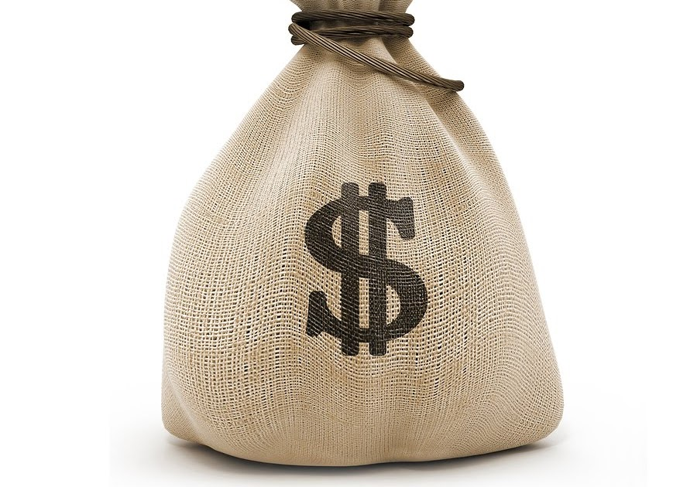
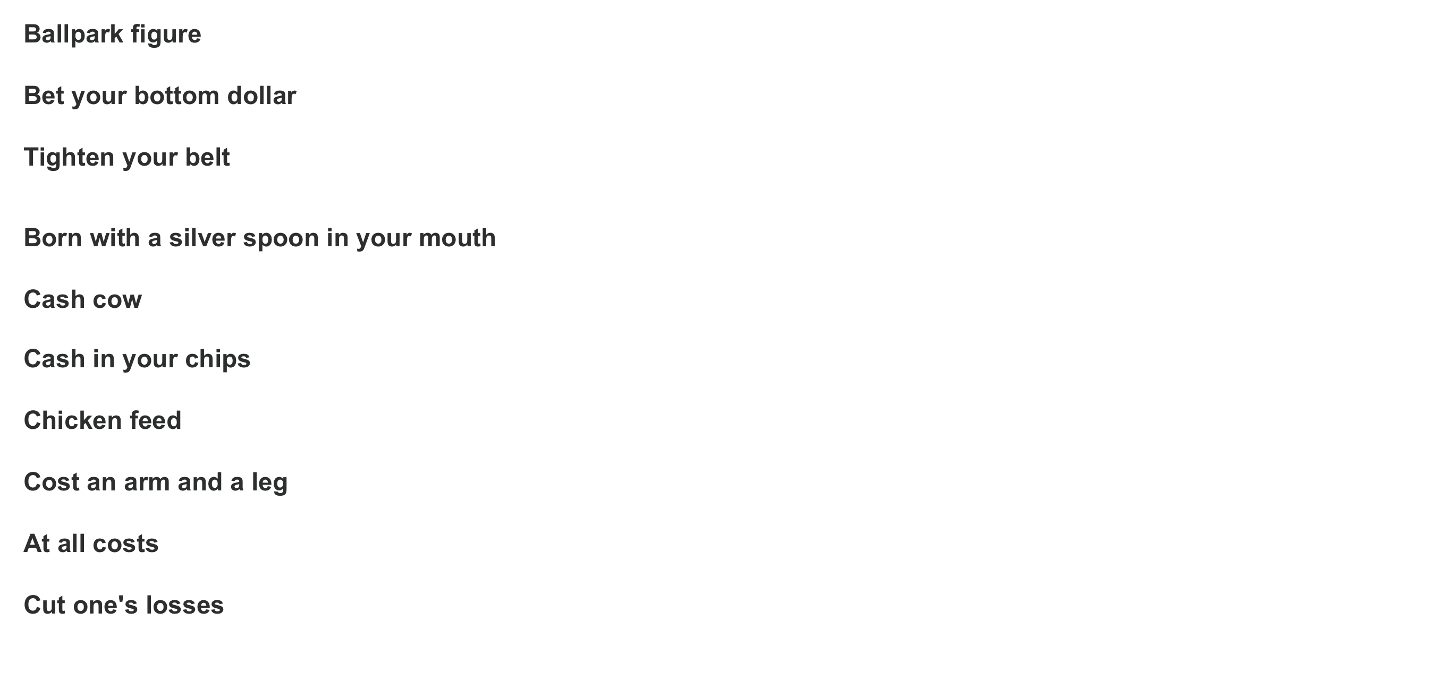
Money (expressions) & conditional

Slide 15
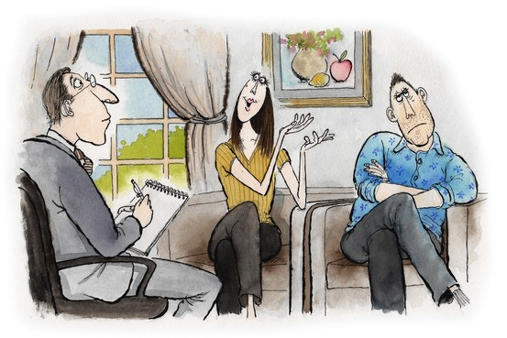
Marriage counseling

Slide 16
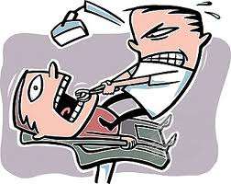
Grammar
I learn
I learned
I will learn
I have learned
I will have learned
I am learning
I will be learning

Slide 17
I learn - Present
XXXXXXXXXXXXXX
Past
Present
Future

Slide 18
I learned - Past
XXXXXXX
Past
Present
Future

Slide 19
I will learn - Future
XXXXXXX
Past
Present
Future

Slide 20
I am learning – Present Continuous
Past
Present
Future

Slide 21
I will be learning – Future Continuous
Past
Present
Future

Slide 22
I had learned – Past perfect
Past
Present
Future

Slide 23
I will have learned – Future perfect
Past
Present
Future

Slide 24
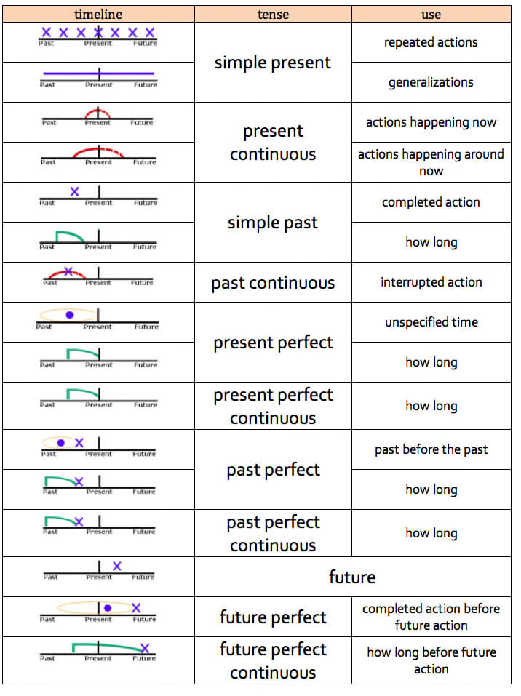

Slide 25
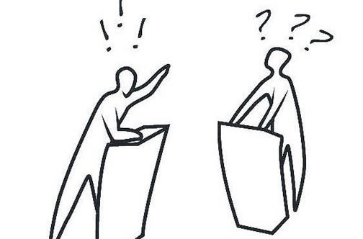
Debates

Slide 26


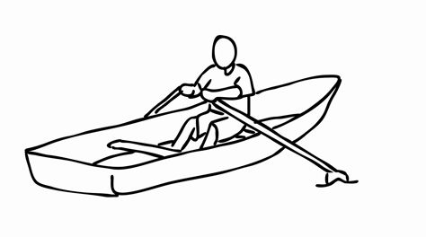



Ethical dilemma
$5.00
THELMA
FRED
PATRICK
STEVE
DONALD

