Slide 1
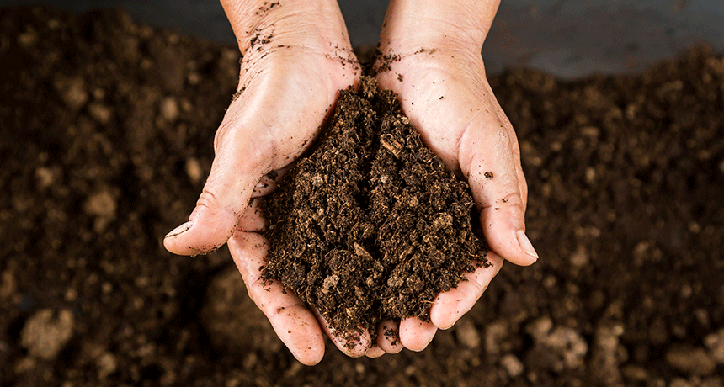
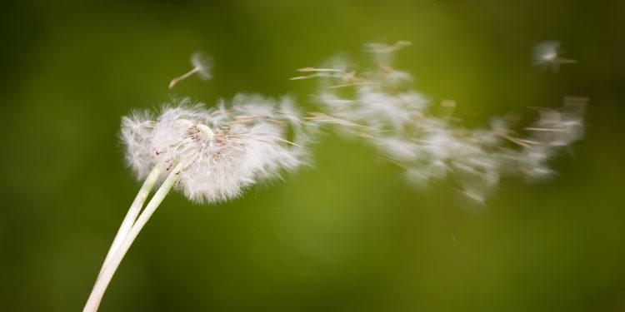
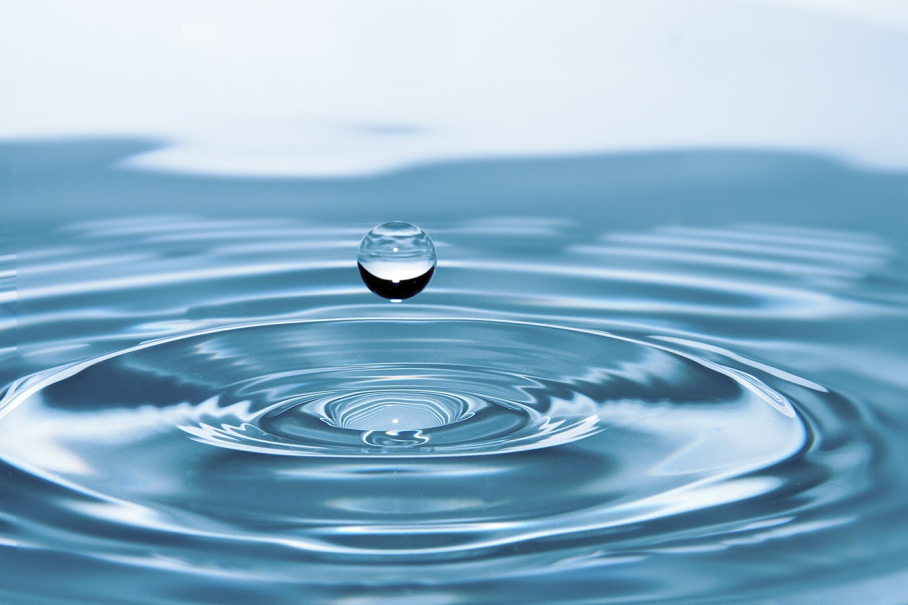
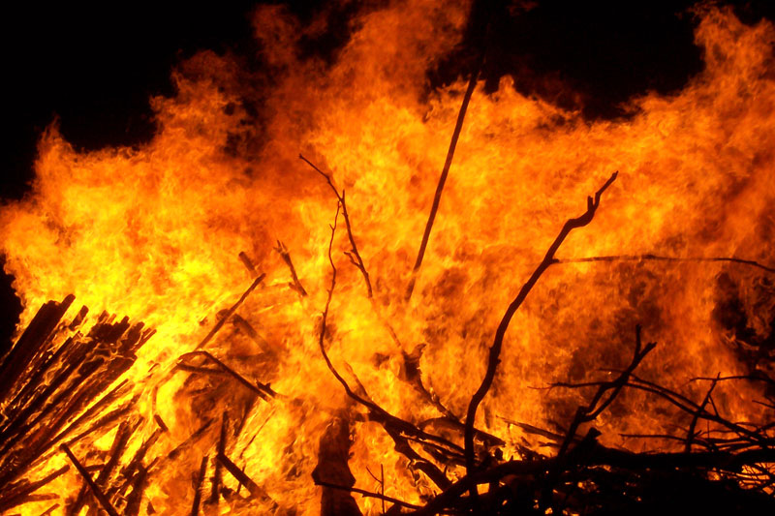
Elements
Earth
Air
Water
Fire

Slide 2
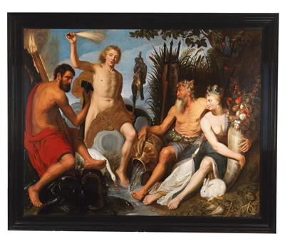

Slide 4
Atoms
Neutrons
Electrons -
Protons +

Slide 5
Periodic table = table of elements

Slide 6
Introduction to the Periodic Table
Atomic Number ● Symbol ● Atomic Weight
Element ● Compound ● Mixture

Slide 7
I am Dmitri Mendeleev!
I made the PERIODIC TABLE !

Slide 8
What is the PERIODIC TABLE?
Shows all known elements in the universe.
Organizes the elements by chemical properties.

Slide 9
How do you read the PERIODIC TABLE?

Slide 10
What is the ATOMIC NUMBER?
The number of protons found in the nucleus of an atom
Or
The number of electrons surrounding the nucleus of an atom.

Slide 11
What is the SYMBOL?
An abbreviation of the element name.

Slide 12
What is the ATOMIC WEIGHT?
The number of protons and neutrons in the nucleus of an atom.

Slide 13
How do I find the number of protons, electrons, and neutrons in an element using the periodic table?
# of PROTONS = ATOMIC NUMBER
# of ELECTRONS = ATOMIC NUMBER
# of NEUTRONS = ATOMIC _ ATOMIC
WEIGHT NUMBER

Slide 14
Now you are almost as smart as I am!
But not as handsome!
Man, I look GOOD!

Slide 15
Elements, Compounds, and Mixtures

Slide 16
What is an ELEMENT?
A substance composed of a single kind of atom.
Cannot be broken down into another substance by chemical or physical means.

Slide 17
What is a COMPOUND?
A substance in which two or more different elements are CHEMICALLY bonded together.

Slide 18
What is a MIXTURE?
Two or more substances that are mixed together but are NOT chemically bonded.

Slide 19
Element, Compound or Mixture?

Slide 20
Element, Compound or Mixture?

Slide 21
Element, Compound or Mixture?

Slide 22
Element, Compound or Mixture?

Slide 23
Element, Compound or Mixture?

Slide 24
Element, Compound or Mixture?

Slide 25
You are still not as handsome as the great Mendeleev!
I am working this beard!
Man, I look GOOD!

Slide 26
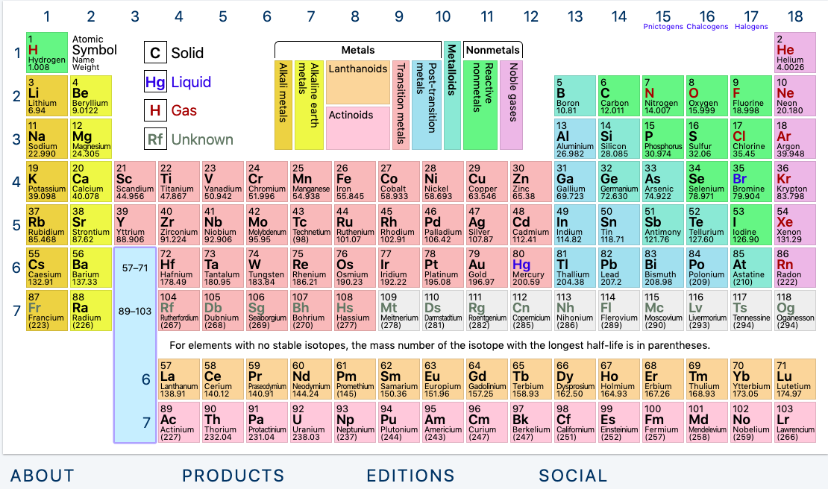
Periods
Nobel Gases
Alkali metals
Earth metals
Halogens

Slide 27
Periods
Nobel Gases
Alkali metals
Atomic mass
Earth metals
Halogens

Slide 28
Atoms
-
Neutrons
+
-
+
+
-

Slide 29
# of protons = # neutrons
(In a balanced atom)
# of neutron =
atomic mass – number of protons

Slide 30
Atoms
Neutrons
Electrons -
Protons +

