Slide 1
How to make a law in Canada

Slide 2
The idea . . . I want all Canadians to wear funny hats!

Slide 3
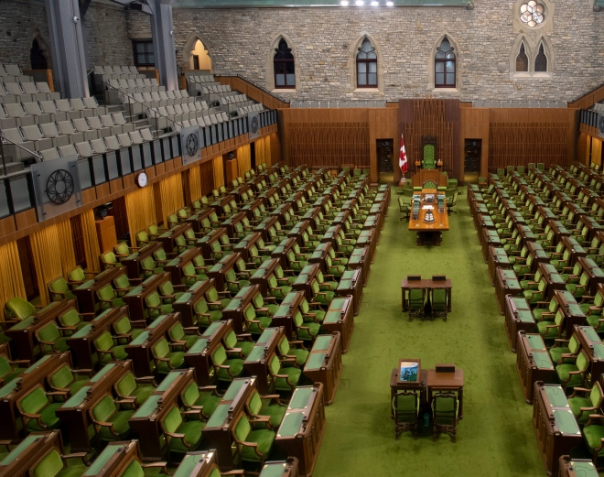
You write to your member of parliament

Slide 4
She takes it to Ottawa – to her political party for a discussion.

Slide 5
They decide to propose a law (a bill)

Slide 6
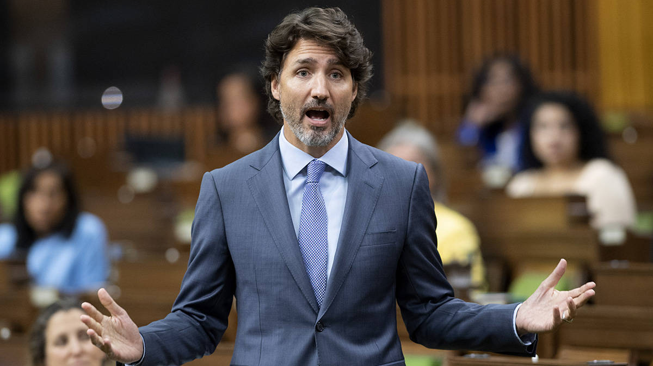
It gets discussed in the house of commons

Slide 7
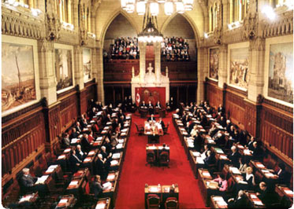
Then it gets discussed in the senate

Slide 8
Then back to the house, then back to the senate, then back to the house, then back to the senate – three readings and revisions of the bill in each house

Slide 9
Then a vote in the house of commons

Slide 10
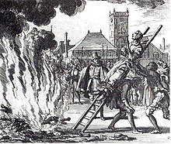
Punishments

Slide 11
Royal assent – the governor general

Slide 12
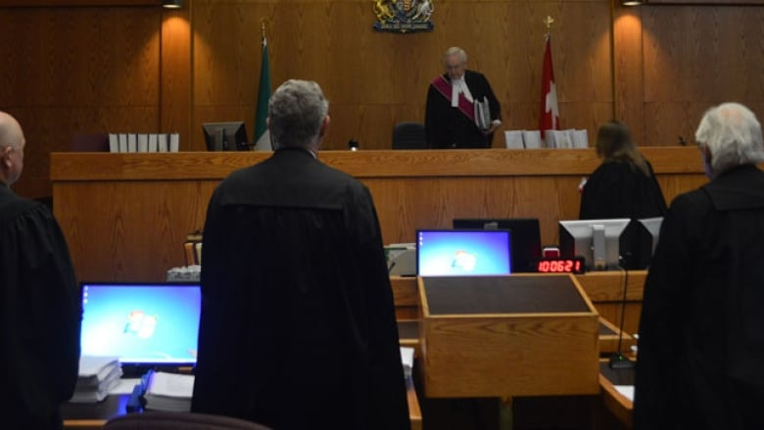
Tested in courts

Slide 13
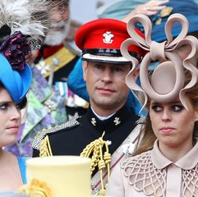
Everyone must wear a funny hat!

Slide 14
Homework
1- Propose a law for all Canadians
2- Find out who your federal member of parliament is
3- What party is s/he part of?
4- Who is the leader of his/her party?
5- How many seats does that party now have in parliament?
6- What are your chances of passing your proposed law?

