Slide 1
Electricity
Amps
Watts
Volts
Resistance
Circuit
Current

Slide 2
Negative – Positive +
Like charges repel
Opposites attract

Slide 3
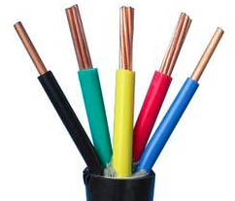
Insulators vs. conductors
Rubber
Glass
Wood
Clay
Oil
Diamonds
Plastic
Copper
Gold
Steel
Salt water
Silver

Slide 4
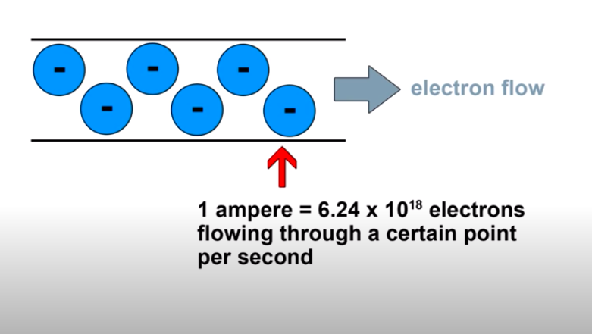
Amperes (amps)

Slide 5
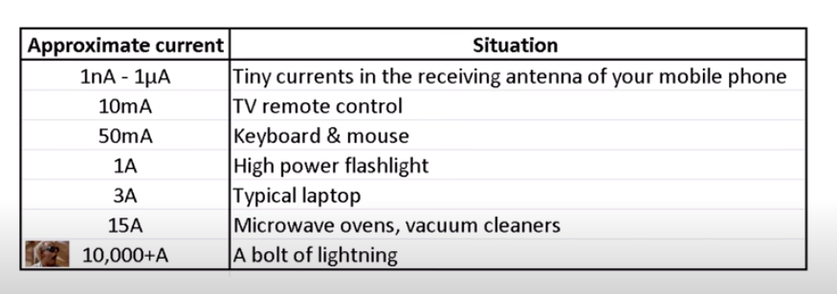
Amps (I)

Slide 6
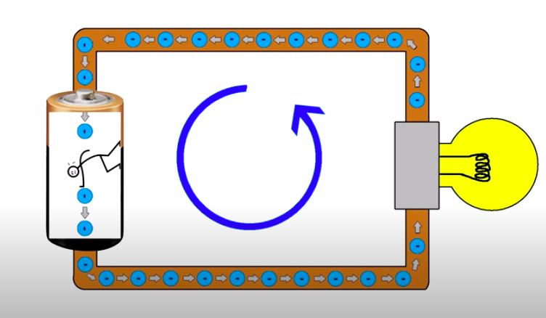
Volts - Energy (volts)

Slide 7
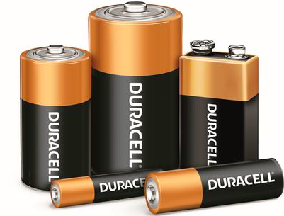
Potential energy (joules)

Slide 8
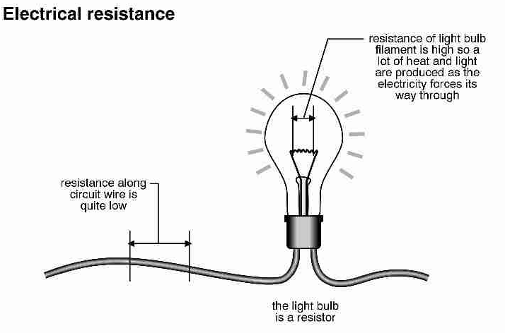
Resistance (ohms - )

Slide 9
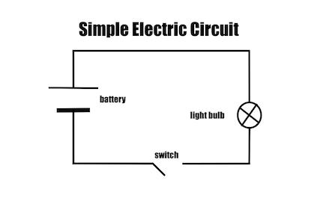

Slide 10
Watts – Power (watts)

Slide 11
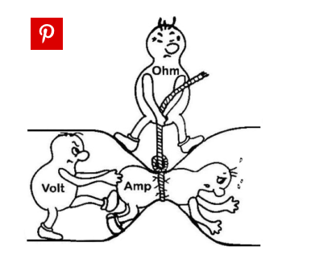

Slide 12
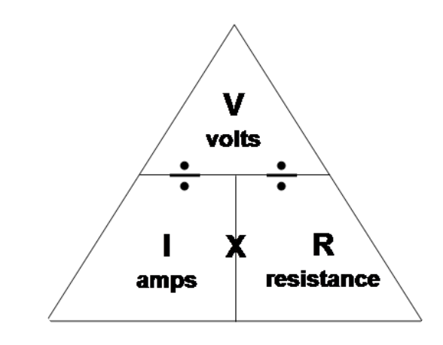

Slide 13
?
100
25
12
40
?
100
5
?

Slide 14
