Slide 1
CHAPTER 2 1896-1945 Nationalisms and Canadian Autonomy

Slide 2
PART 1 Canada’s place in the British Empire

Slide 3
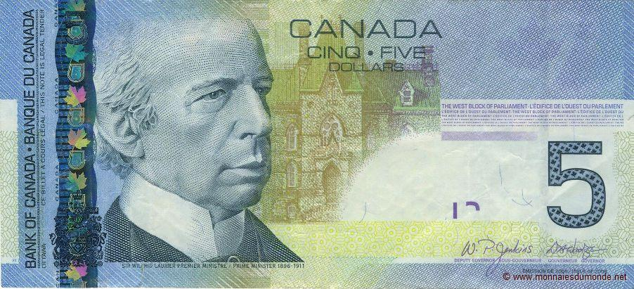

Slide 5
2 opposed political doctrines
FRENCH-CANADIAN NATIONALISM
BRITISH IMPERIALISM

Slide 6
Imperialism VS French- Canadian nationalism
English-Canadian imperialists:
were proud to belong to the British Empire.
believed that Canada should be involved in the Empire’s expansion throughout the world.
some believed in the superiority of the “Anglo-Saxon” race, and the need to protect it and perpetuate it.
There were also a few French-Canadian imperialists!

Slide 7
The Royal Union Flag or Union Jack (1801-1965)
The British flag
It was used across British North America and in Canada.

Slide 8
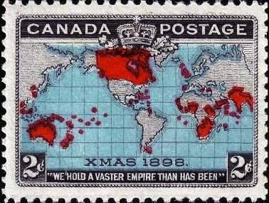
A Canadian postage stamp issued on December 7, 1898
It captures the feeling of pride in belonging to the British Empire.
All of the territories in the British Empire are represented in red.

Slide 9
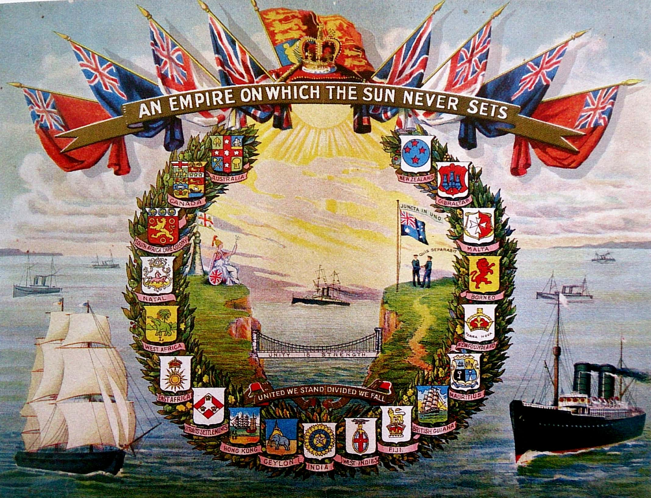

Slide 10
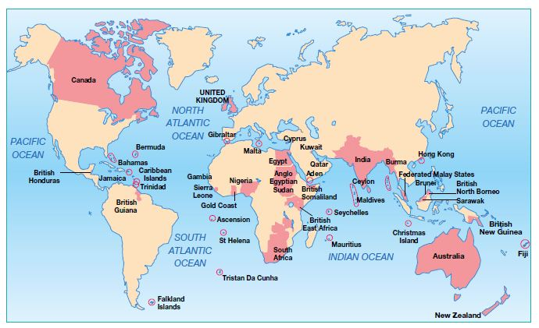

Slide 11
The Victoria Memorial at the centre of Victoria Square in Montréal
Bronze and granite work of the sculptor Marshall Wood.
Unveiled in 1872 by Lord Dufferin, the Governor General of Canada at the time.

Slide 12
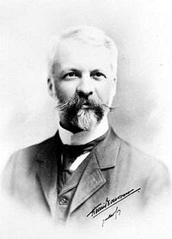
Imperialism VS French- Canadian nationalism
French-Canadian nationalists (1):
led by Henri Bourassa (founder of the newspaper Le Devoir in 1910 and grandson of Louis-Joseph Papineau).

Slide 14
Imperialism VS French- Canadian nationalism
French-Canadian nationalists (1):
were anti-imperialists
wanted to close the divide between English Canadians, French Canadians and immigrants so as to foster a unified nationalism that was respectful of differences
demanded that the federal government respect the jurisdictional autonomy of the provinces
demanded greater autonomy for Canada from the UK
were against Canada’s involvement in the Empire’s wars
defended the language and religious rights of French Canadian Catholics.

Slide 16
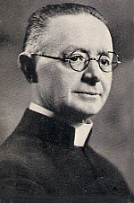
Imperialism VS French- Canadian nationalism
French-Canadian nationalists (2):
The Catholic priest Lionel Groulx was a clerico-nationalist, a more extreme type of nationalism.
Clerico-nationalism guided French-Canadians toward the Church’s values:
French language
Catholic faith
farming as a defense against the dangers of the city and as a way to gain economic independence (rural way of life)
survival in Canada among an Anglo-Protestant majority
upholding the Canadian federation..

Slide 18
Imperialism VS French- Canadian nationalism
Imperialists and French-Canadian nationalists BOTH:
feared an American takeover of Canada
promoted the importance of the “Canadian race”.

Slide 19
Canadian military support
1) The Boer War / South African War (1899-1902):
The Boers were descendants of Dutch settlers who arrived in the British colony of South Africa and established the republics of the Transvaal and the Orange Free State.
In the mid-19th century, the Boers wanted independence from the UK, which was denied.
The UK wanted continued access to the territories’ gold and diamond mines, and to maintain political control of the region to counterbalance the German influence in nearby African colonies.
War between the British and the Boers broke out in 1899.

Slide 20
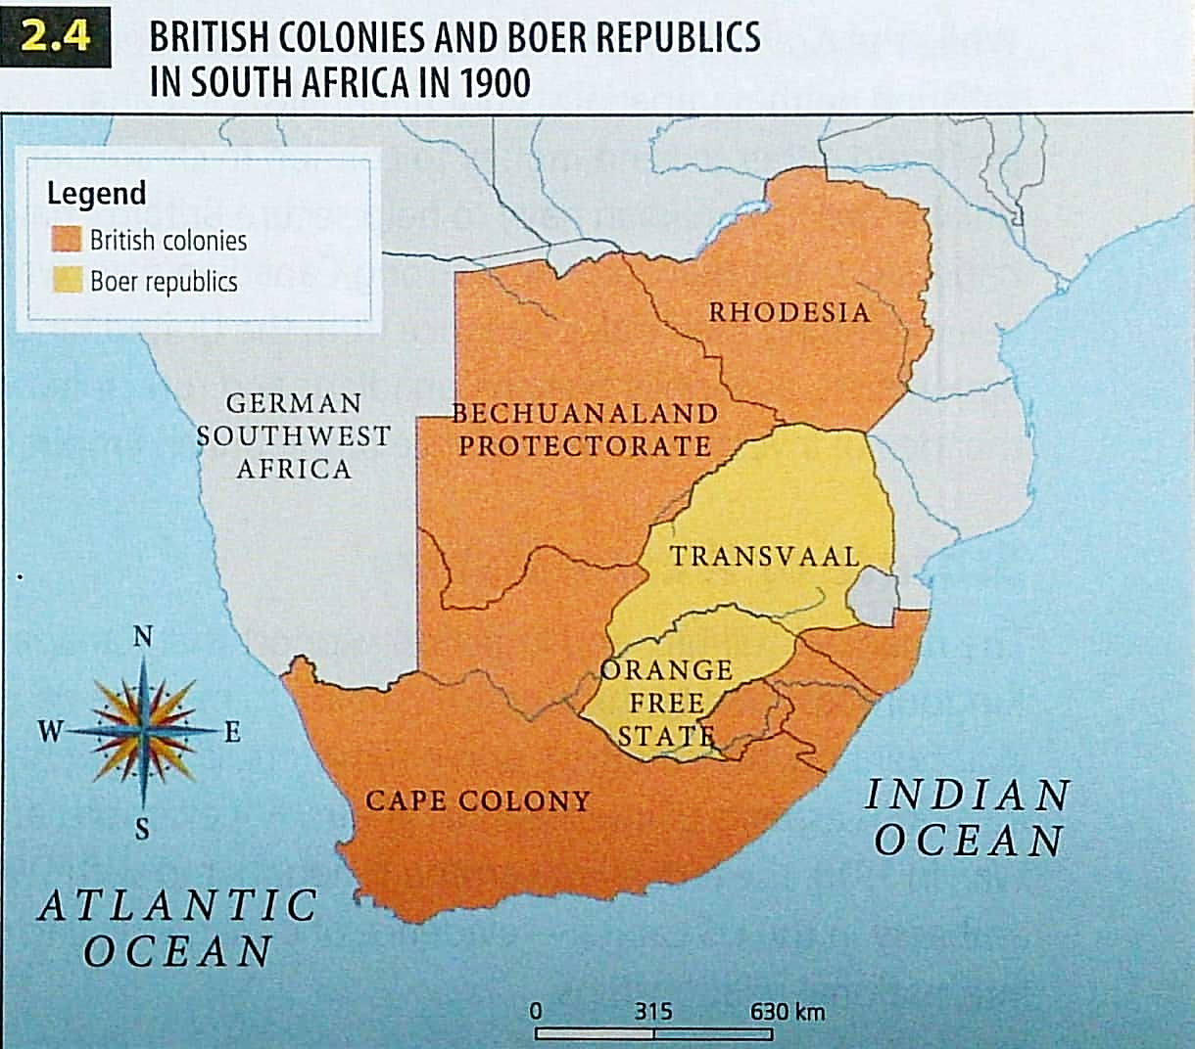

Slide 21
Canadian military support
1) The Boer War / South African War (1899-1902):
The UK called on its colonies and dominions to send troops to fight in South Africa. So, as a dominion, Canada was expected to fight.
In Canada, on one side, imperialists supported sending soldiers to protect the Empire.
On the other side, nationalists opposed sending soldiers because, to them, it would be a waste of resources and human lives, and they feared that their participation would cause a precedent for future wars.
In the end, the Laurier government tried to compromise by:
contributing $3 million to the war effort
sending 1,000 volunteers to the front lines (+ 6,368 later on).

Slide 22
Canadian military support
1) The Boer War / South African War (1899-1902):
“Canada, and especially the province of Québec, has no choice but to take up the quarrels of England, Russia, France, Germany and the United States. We are raising our children for more than to spill their blood […] in all the oceans and continents of the world.”
[TRANSLATION]
L’Avenir du Nord

Slide 23
Canadian military support
1) The Boer War / South African War (1899-1902):
“While everyone supports sending soldiers, Québec is obstructing these efforts, and the representatives of this people, to whom the motherland has offered so many privileges and special concessions, have shamed us in front of the whole world […] . Never has the Canadian heart beat so strongly in unison with the British; but it has been constricted by French-Canadian apathy; Québec has stopped their hearts from beating as one.”
News

Slide 24
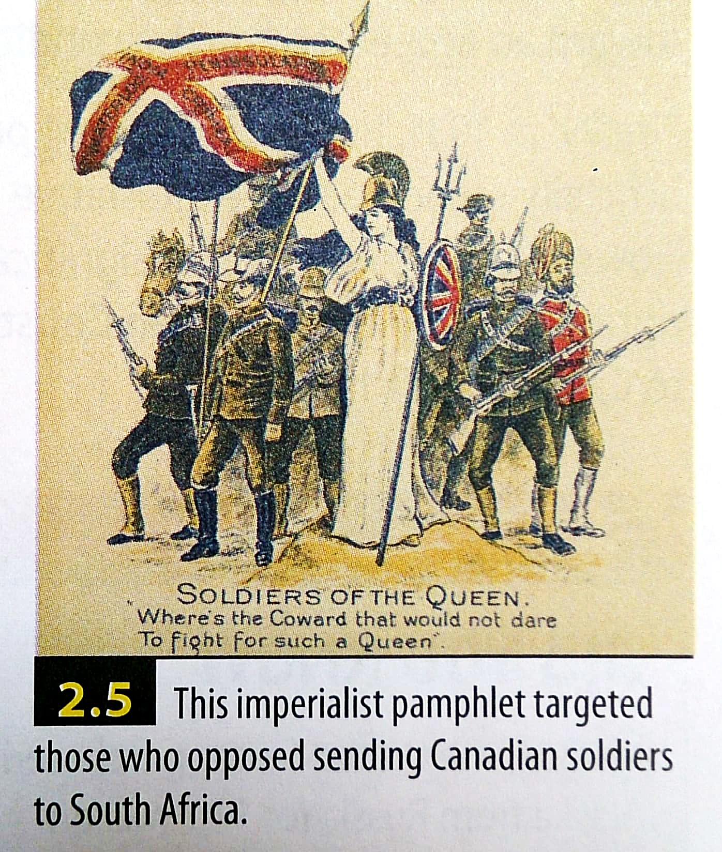

Slide 25
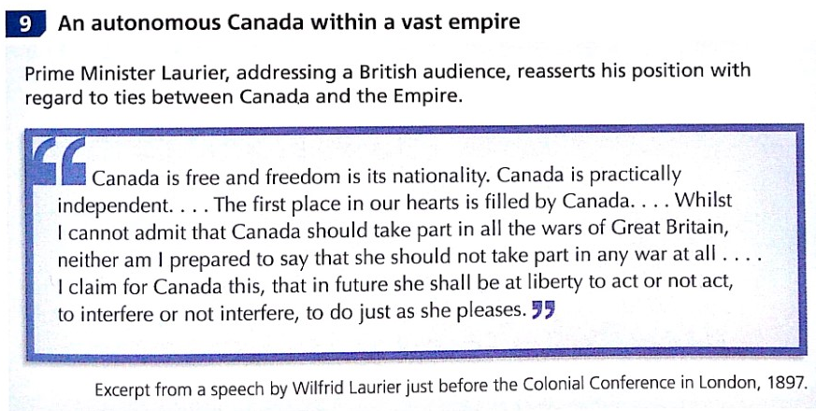

Slide 26
Canadian military support
2) Creation of the Canadian navy (1910):
In the early 20th century, the UK called on its colonies to send money to help maintain its Royal Navy because it feared Germany’s growing power.
In 1910, the Naval Service Act was passed, which lead to the creation of the Royal Canadian Navy to patrol and protect Canada’s territorial waters. Our naval force was modest with only 379 sailors in 1914.

Slide 27
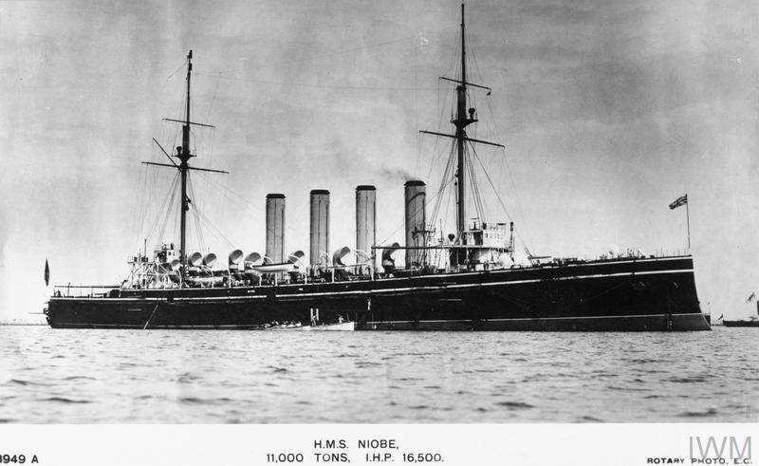
HMS Niobe
One of the two Canadian ships at the outbreak of WW1 in 1914.

Slide 28
Canadian military support
2) Creation of the Canadian navy (1910):
Imperialists would have preferred either to send money to London for better combat units, or to build a strong Canadian navy to help secure Britain’s naval supremacy.
Some nationalists felt like having a Canadian navy would help to become independent from UK, while other nationalists rejected the idea of investing in the defence of the British Empire.

Slide 29
Canadian military support
3) League of Nations (1919-1945):
An international organization founded by the victorious countries of the First World War.
Its mission was to ensure world peace.
The Dominion of Canada was accepted as a separate member from the UK.
It was replaced by the United Nations (UN) at the end of the Second World War.

Slide 30
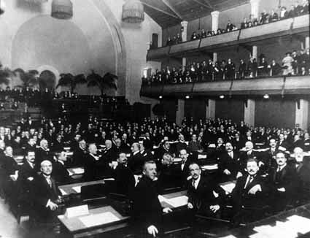
The first meeting of the League of Nations (1920)
The city of Geneva, Switzerland was chosen as the headquarters because it was generally neutral.
Canada’s membership marked an important step in its move toward greater autonomy from the UK.

Slide 31
Canadian military support
4) Statute of Westminster (1931):
Passed by the British Parliament, it officially recognized the legislative independence of the British dominions (like Canada).
Canada gained full autonomy over its internal and external affairs.
HOWEVER, there remained a significant limitation: British Parliament kept the right to modify the Canadian Constitution until 1982.

Slide 32
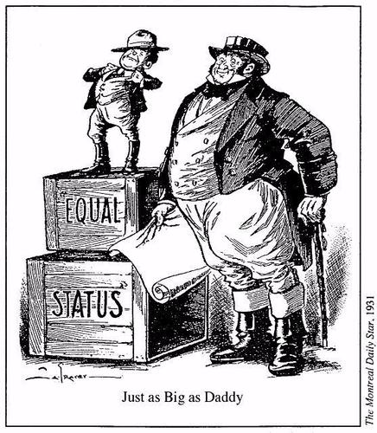

Slide 33
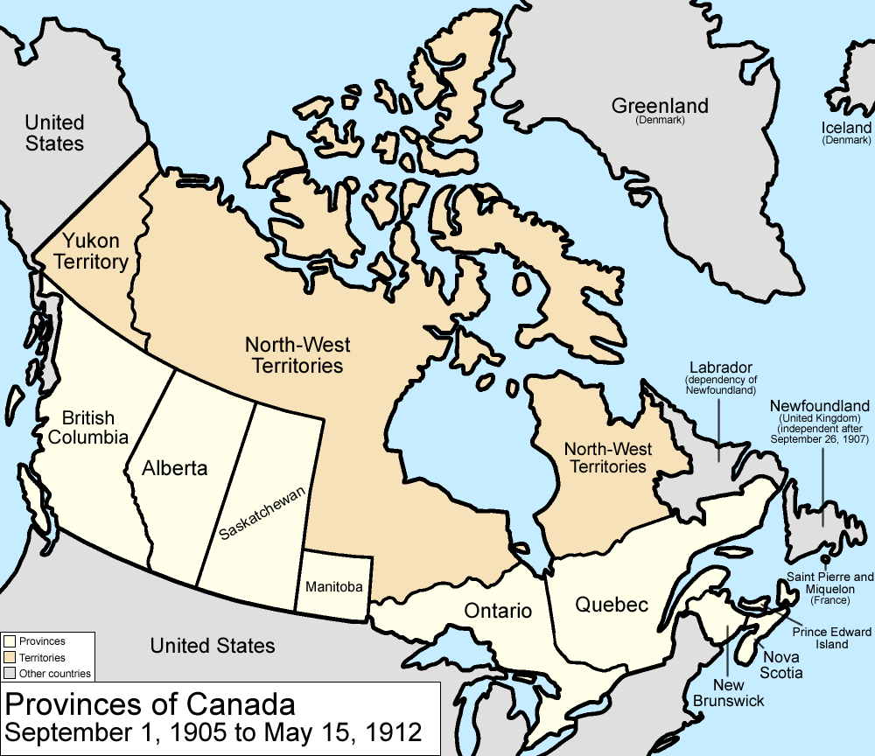
Canadian territory
Map of Canada in 1905
The influx of immigrants to the Prairies led to the creation of 2 new provinces: Saskatchewan and Alberta.
The territories of Québec and Ontario were expanded northward toward the Hudson Bay.

Slide 34
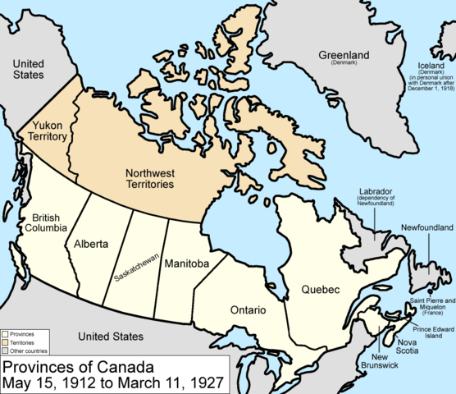
Canadian territory
Map of Canada in 1912
Manitoba, Ontario and Québec requested that their borders also be extended northward, which was granted.

Slide 35
Governance of First Nations and Inuit populations
By the turn of the 20th century, Indigenous people:
were a minority in Canada
were isolated in federally controlled reserves
malnutrition
lack of medical care
overcrowded housing
spread of serious diseases (like tuberculosis)
were trying to survive when the Canadian government wanted to assimilate them (their rights and their cultures were not recognized)
had signed treaties with the Canadian government that were often detrimental to them
were forced to send their kids to residential schools.
In the 1940s, they became more politically active, complaining about their living conditions and the government’s failure to respect treaty agreements.

